Slide 1

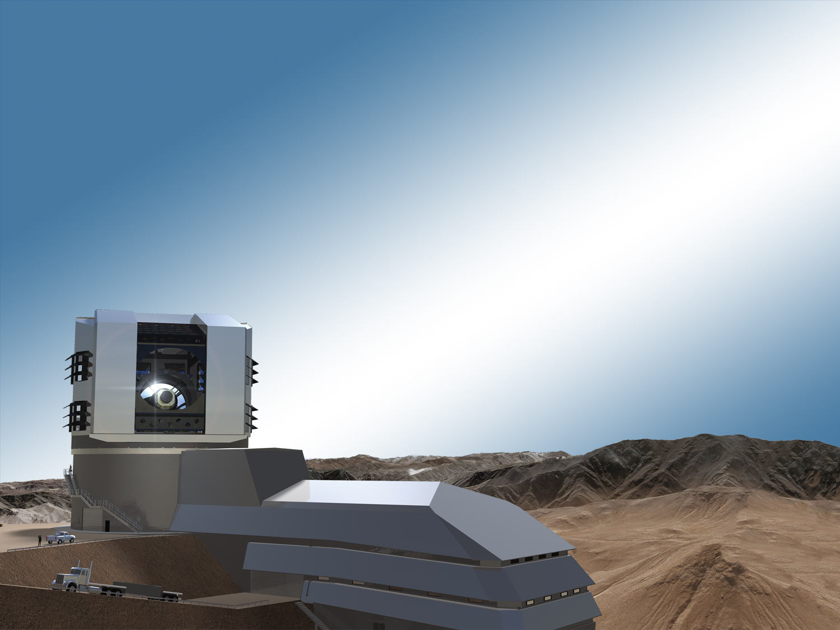
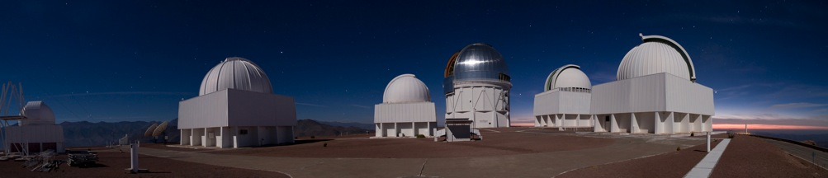
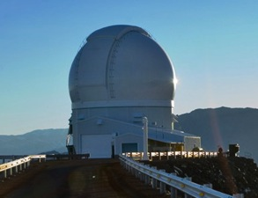
50 Years of Wide Field Studies
Robert Blum

Slide 2
Outline
History
The Galactic Bulge
Cosmology
Magellanic Clouds

Slide 3
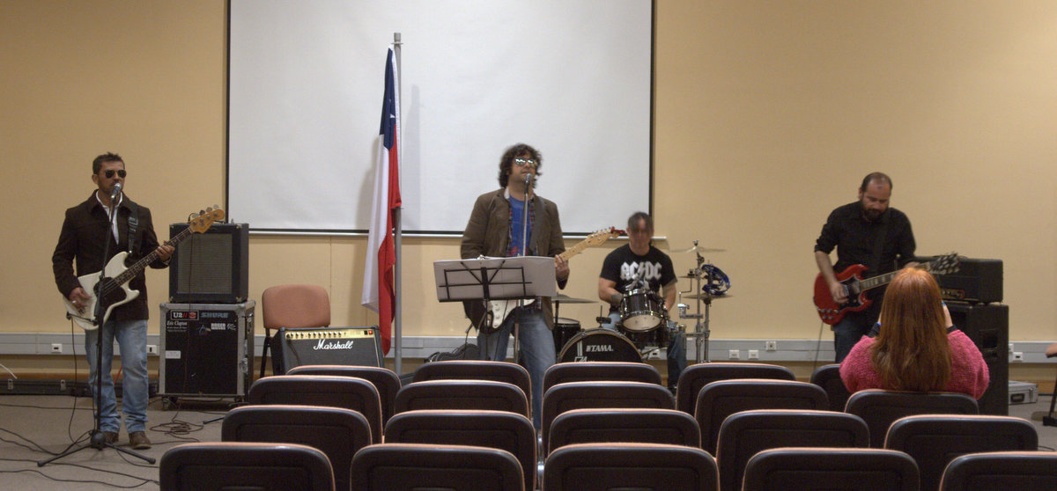
Preliminaries
Notes:
Thanks to Andrea Kunder and Sean Points
Thanks to Ximena Herreros and Leonor Opazo

Slide 4
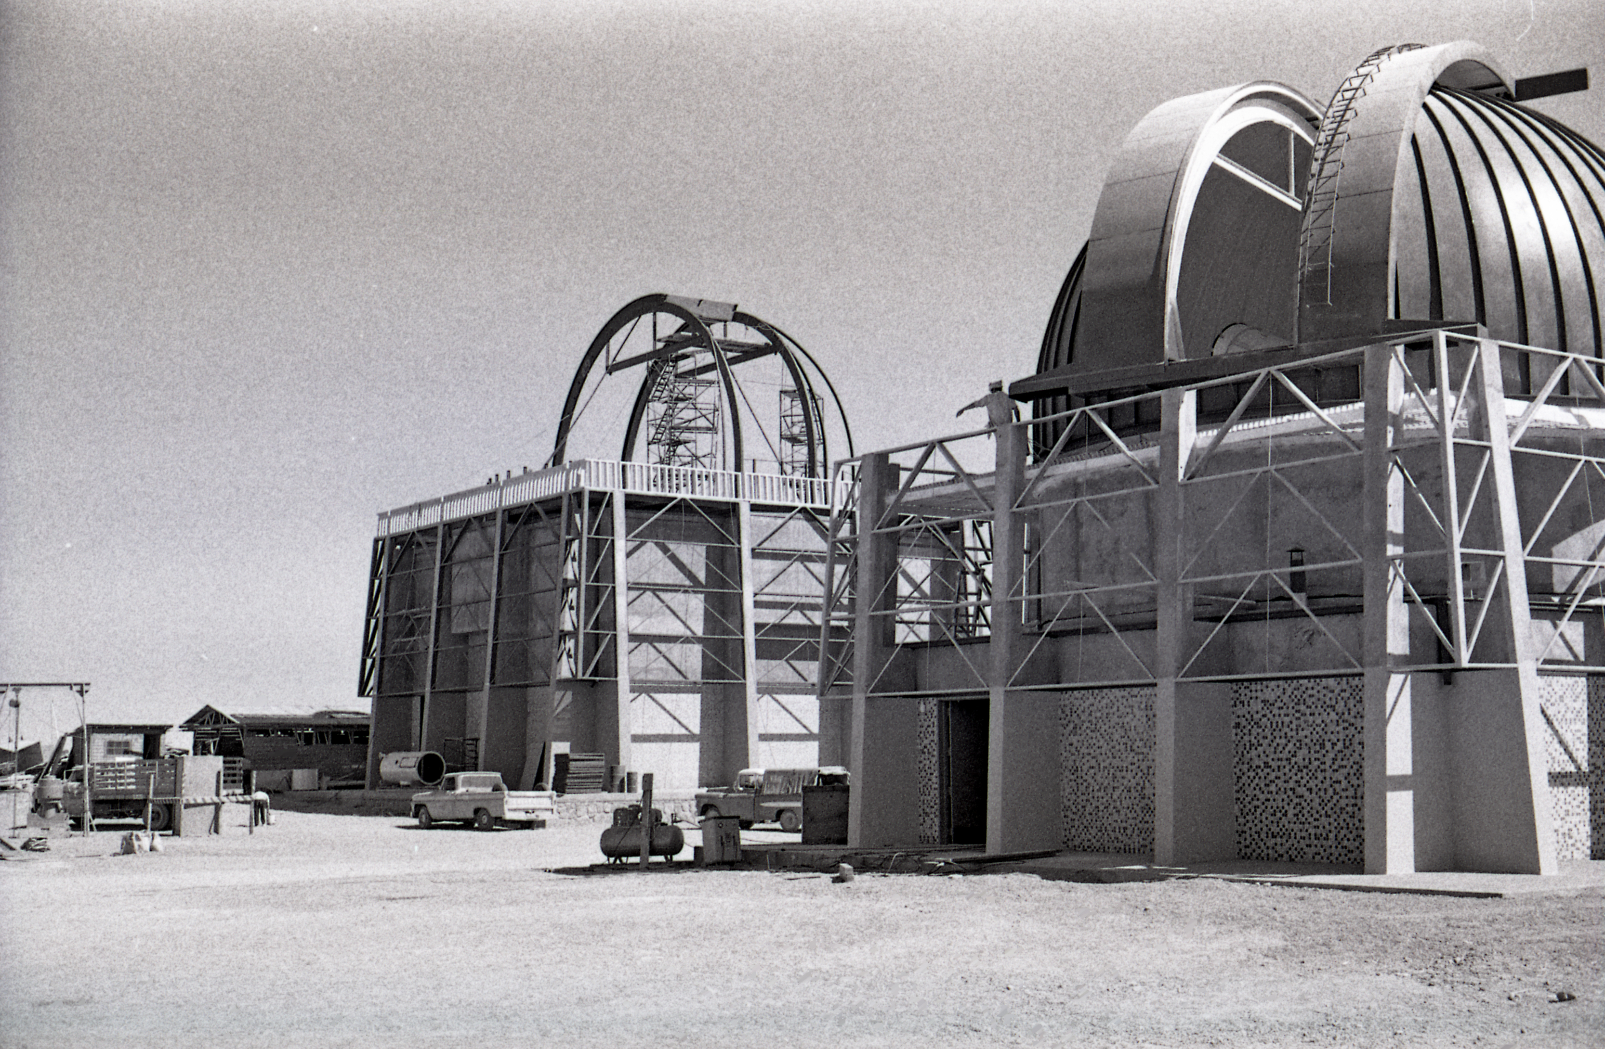
History
Notes:
Arrived in 1997. Thanks to Malcolm Smith, Sidney Wolff and science staff who took a chance on me. Thanks to my family for coming down as well. It was an incredible experience for all of us.
CTIO is one of the great observatories of the world. For my part it is the greatest.

Slide 5
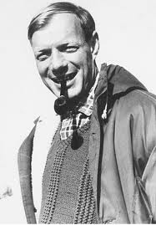
Vivas, Jurgen Stock
Site survey results from Chile outreach to UC (F. Rutulant)
Stock truly enjoys this “work” (Blum site testing in northern Chile). “The most beautiful time of my life.”
Emphasizes critical assistance from the locals (Don Fidel).

Slide 6

Hesser, Blanco
Humanity
Family
Vision for all staff
  Research
  Dedication to visitors
  Develop instruments
“Victor didn’t want us to change light bulbs”
- Bruce Atwood

Slide 7
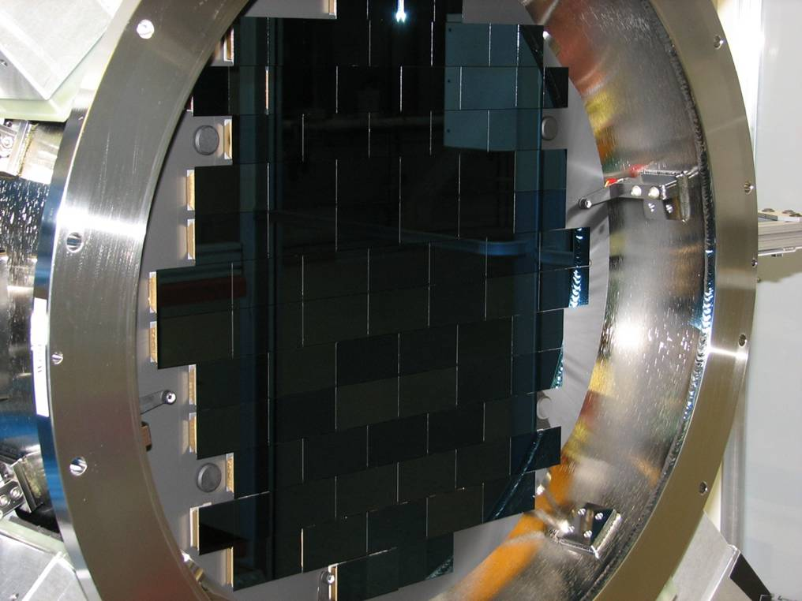
CCDs, Walker
Tololo was a leader in CCD development
This is an example of Victor’s vision (service, development, science) -> drive field forward
IRAF played important role
New ways to contribute: DECam, Monsoon
IR Detectors/controllers too. ISPI.

Slide 8
Seitzer, Osmer, M. Smith
Context was rapid scientific advancement
On the bleeding edge with new electronic detectors
Our budget has been going down since the 80’s!
First divestiture in 2000!
Revitalization through Pachón (Gemini, SOAR, Brazil)
Change is good!
EPO: Mamalluca

Slide 9
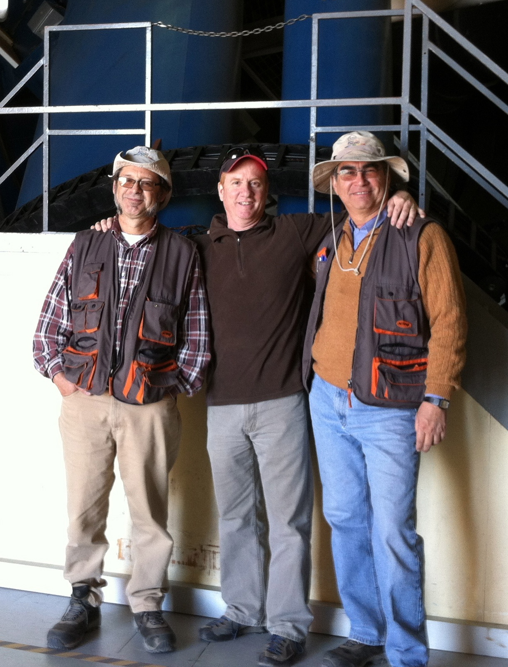
Why CTIO is Great
Grand confluence of nature (climate), southern sky (MC’s and Galactic bulge), and people.
Those who came/come after owe a huge debt of gratitude (we can date our time by the vehicles on the mountain: Hesser golf carts, You-Hua, Abi VW’s)
Chilean staff are the glue that hold it all together (we have dedicated our lives to astronomy, they have too. And to something bigger in some ways: CTIO).
All the work is its own reward, we are the fortunate ones.

Slide 10
The Galactic Bulge

Slide 11
The Galactic Bulge
Excellent talks on Bulge
  Modern work builds off of Whitford, Frogel, Terndrup, Rich, McWilliam
  Rich+, BRAVA: Boxy/X bulge -> classical bulge minimal, but radial metallicity gradients?
  Poleski, PM’s from Ogle, X kinematics
  Britt, Chandra survey and optical counter parts. Finding NS/BH and understanding what’s going on in the mass gap between the two.
  Kunder, split HB -> Bulge Building Blocks

Slide 12
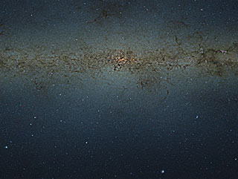
The Galactic Bulge
VVV! Minniti, Geisler, Cohen, Hempel, Dekany, Mauro, Alonso-García
  Deep infrared five filter survey + variable star survey (Ks)
  New globular clusters!
  Age-metallicity relations
  Auto classification of LC

Slide 13
The Galactic Bulge
Zoccali review, chemical enrichment
  Rich MDF holds up, continual improvement and now we can break into 5 components
  Bensby dwarfs are still a challenge: how can there be such a significant fraction of young stars?
    Nataf argues biases in u lensing sample reduces number, but still significant. He abundance can play important role.
    Gennaro and Rich argue for essentially all old stars.
Calamida
  Cooling sequence WD in bulge

Slide 14
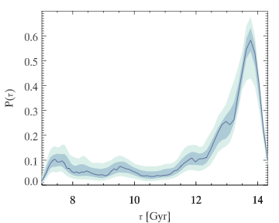
The Galactic Bulge
Gennaro, detailed SFH of Bulge (Ogle29), HST Treasury. “No room for young stars” + IMF slope very shallow

Slide 15
The Galactic Bulge
Ortwin Gerhard
  Secular evolution of bulge naturally results in boxy bulge -> X structure
  Binding energy of stars at center of disk is large. Bar formation can move stars around, but not that much -> gradient can still exist in bulge.
  Reproduces main aspect of VVV metallicity diagram.
  We now have everything in hand…

Slide 16
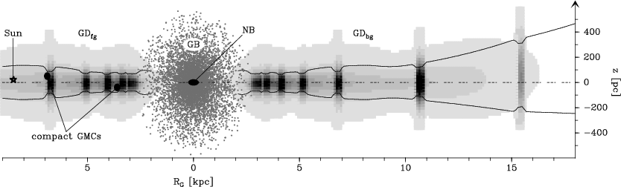
The Galactic Bulge
Bono
  Galactic metallicity gradients don’t match up.
  Last major unsolved riddle or clue for MW formation?
Notes:
Kinematic studies will help sort this out.

Slide 17
Cosmology

Slide 18
Cosmology
Highlights
  Beers, MP stars -> now seeing imprint of first generation
  Sippel, size vs metallicity in clusters through N body simulations
  Mould, Y band drops outs at z ~ 6 now with DECam!

Slide 19
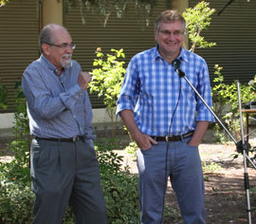
Cosmology
Hamuy, Calán/Tololo SN Survey

Slide 20
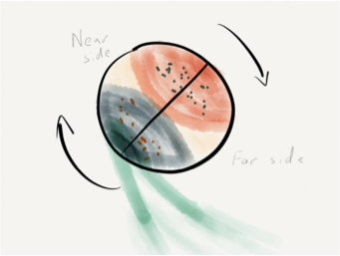
The Magellanic Clouds
Córdoba (Piatti, Palma, Parise)
  Clusters, AMR
  Age Gap?
Olsen
  LMC – SMC interaction
  Evidence for collision, stripping of SMC stars->LMC
  Initiated recent star burst?
  Dynamical model consistent with age gap?
Moni Bidin
  Young Stars in Leading Arm

Slide 21
The Magellanic Clouds
Surveys
  Ogle I-IV, Udalsky, u Lensing, exoplanets, TNOs …
  NIR Variables Survey, Matsunaga, IRSF/SIRIUS
  Inno: 3D models models using the Cepheid's
  Winkler: MCELS
  Aguayo (Martayan): Be star survey in the MC’s
  Vivas: Dwarf Cephids in Carinia

Slide 22
The Magellanic Clouds
Rest, SN Light Echoes
  1987A: 3D view of explosion
  Eta Car, G supergiant

Slide 23
The Magellanic Clouds
You-Hua, YSOs
  Thanks for calibrating the SAGE models! (obviously context is important)
  Global Gravitational instatbilities
  Triggered SF
Selman (aka Melnick)
  Lots of new information in R136 challenging our “proven” models
  New technologies -> MAD and GeMs

Slide 24
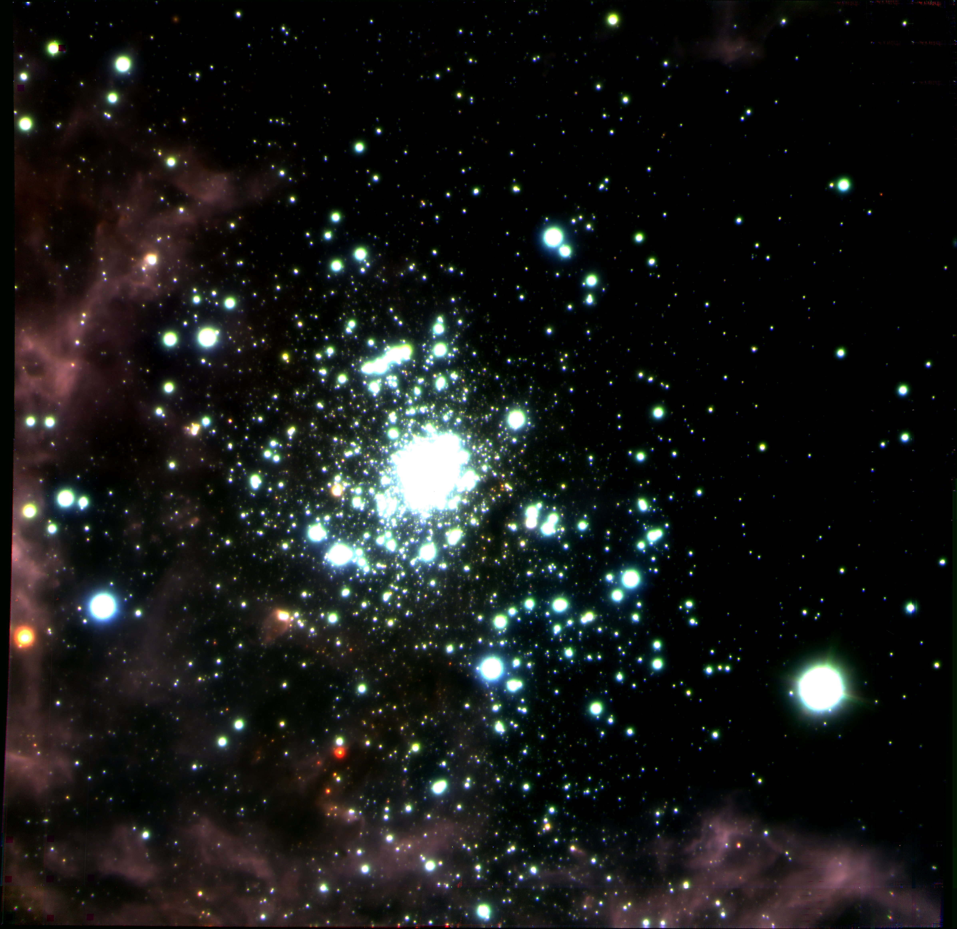
The Magellanic Clouds
Notes:
One red sources may be You-Hua’s YSO

Slide 25
The Magellanic Clouds
Drout
  Beautiful review of massive star evolution and testing, improving models through large data sets
  Work by Massey and collaborators very important in understanding YSG, RSG, LBVs
  Important connections to SN studies
  Still work to do (WC/WN, SN impostors)

Slide 26
The Magellanic Clouds
Saha
  Smooth structure to large distances, extended disk detected at 12 scale lengths
  Halos not ruled out
  Old stellar disk a puzzle
  Now testing detailed SMC-LMC dynamical models, even more to come with DECam.

Slide 27
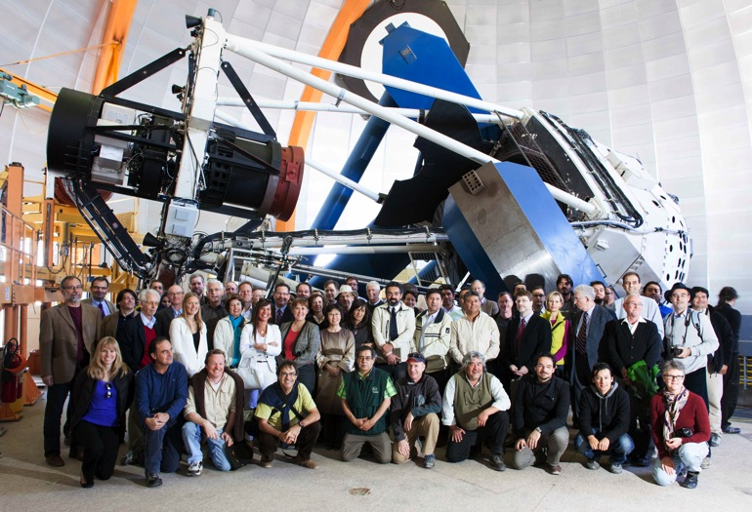
The Next 50 Years Start Now
Chris Smith
  DECam
  LSST Era

