Slide 1
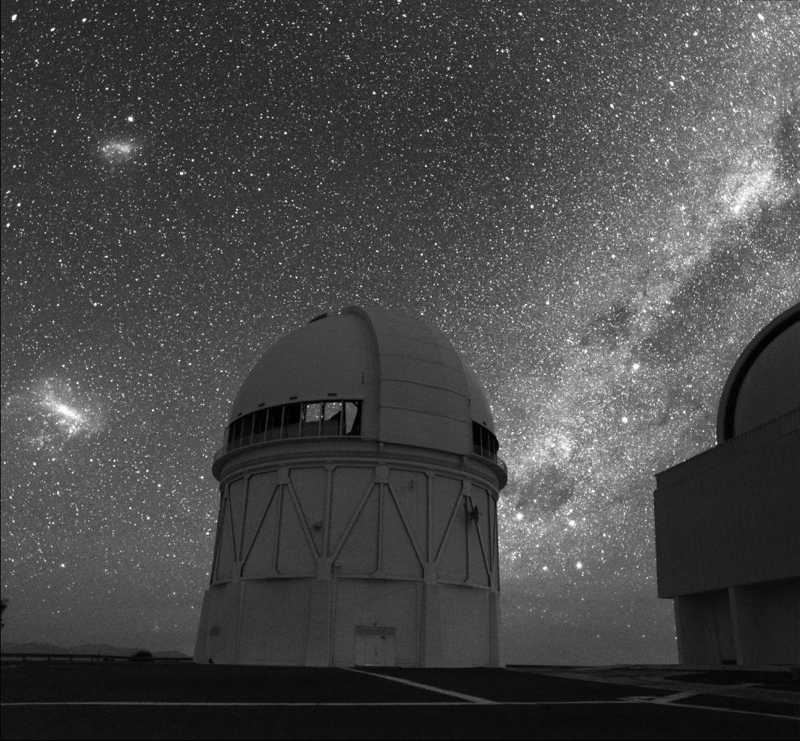
A Stellar Heist in the Magellanic Clouds
Knut Olsen (NOAO)
CTIO 50 Years Conference
Image credit: Roger Smith

Slide 2
Contributors
Phil Massey
Bob Blum
Dennis Zaritsky
Brianna Smart
Martha Boyer
Karl Gordon
Abi Saha
Ed Olszewski
David Nidever
Gurtina Besla
Tim Axelrod

Slide 3
Overview
Results based on new collection of ~6500 LMC stellar velocities plus ~1000 existing velocities
Dataset allows for examination of internal kinematics of different subpopulations
Also allows identification of stars with peculiar kinematics
Have found that ~5% of the LMC’s stars likely came from the SMC

Slide 4
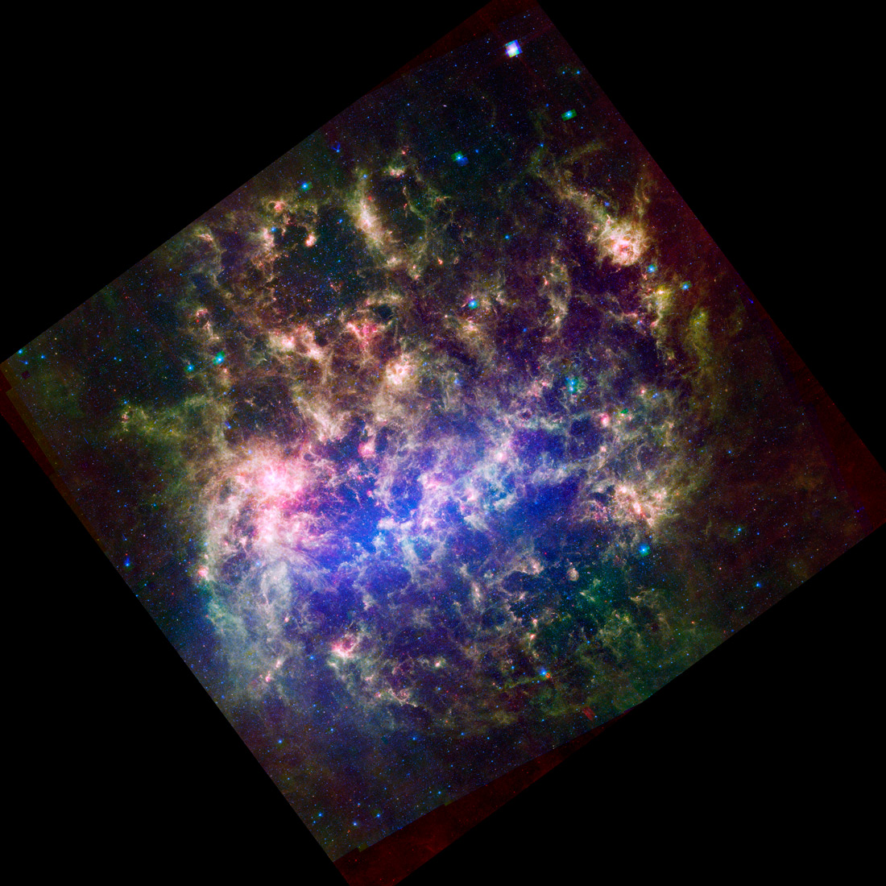
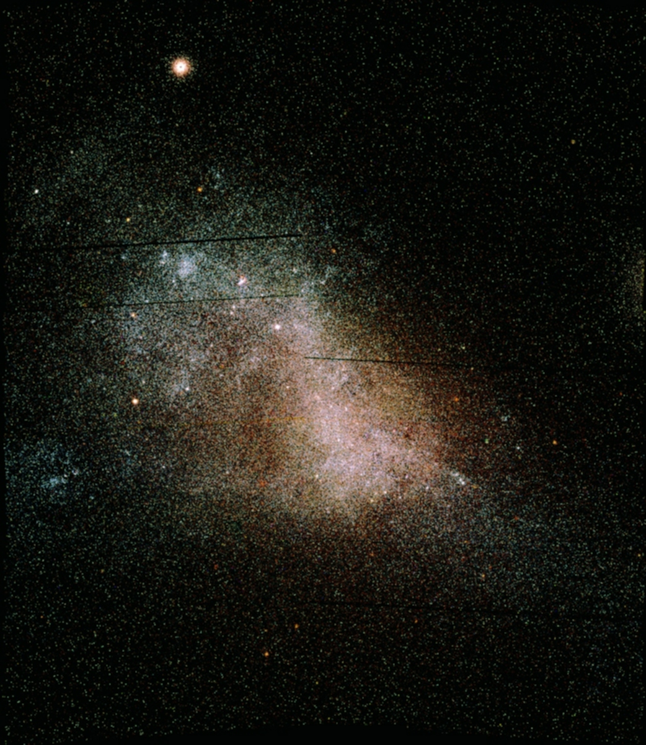
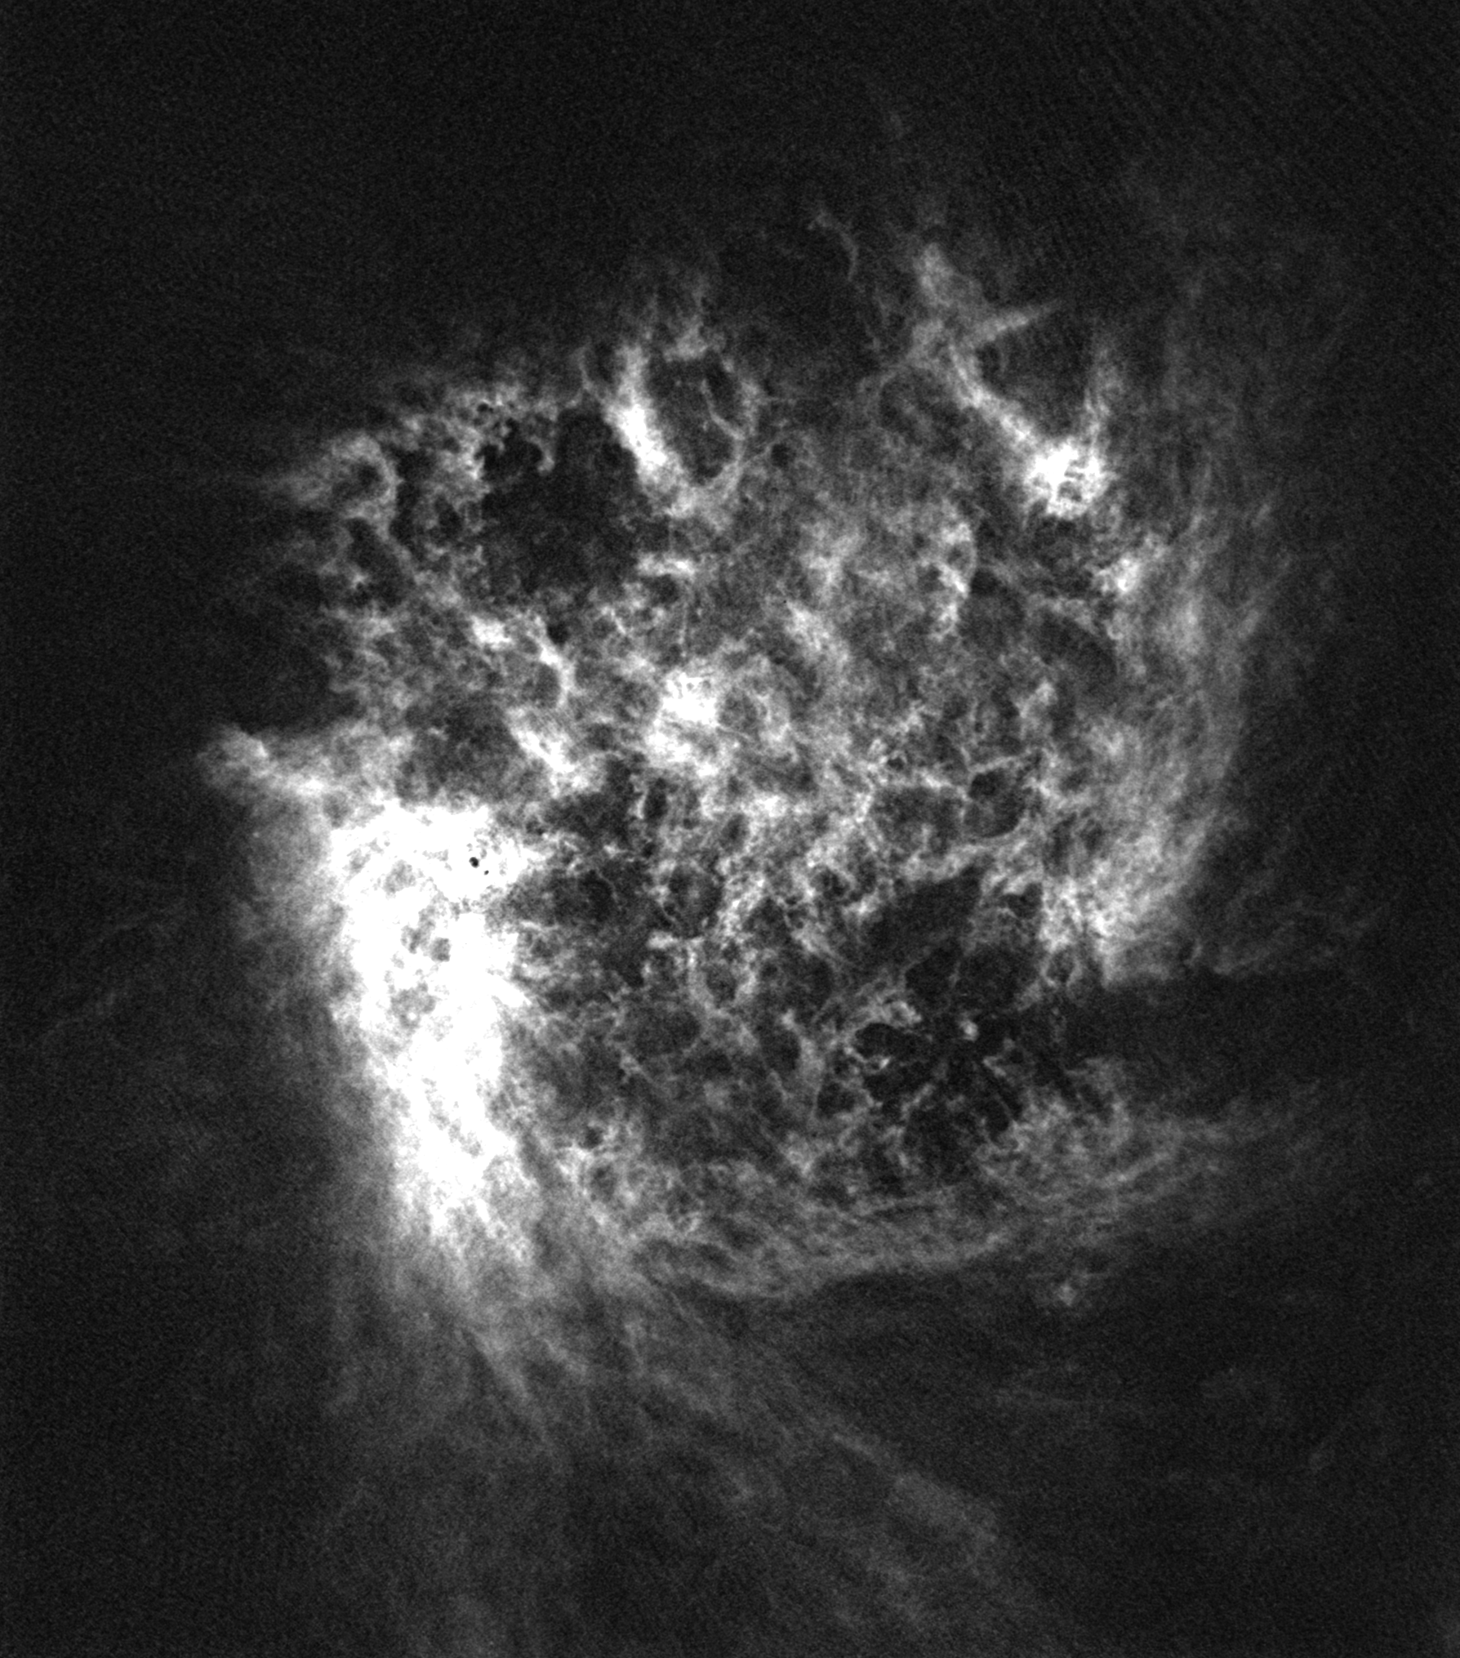
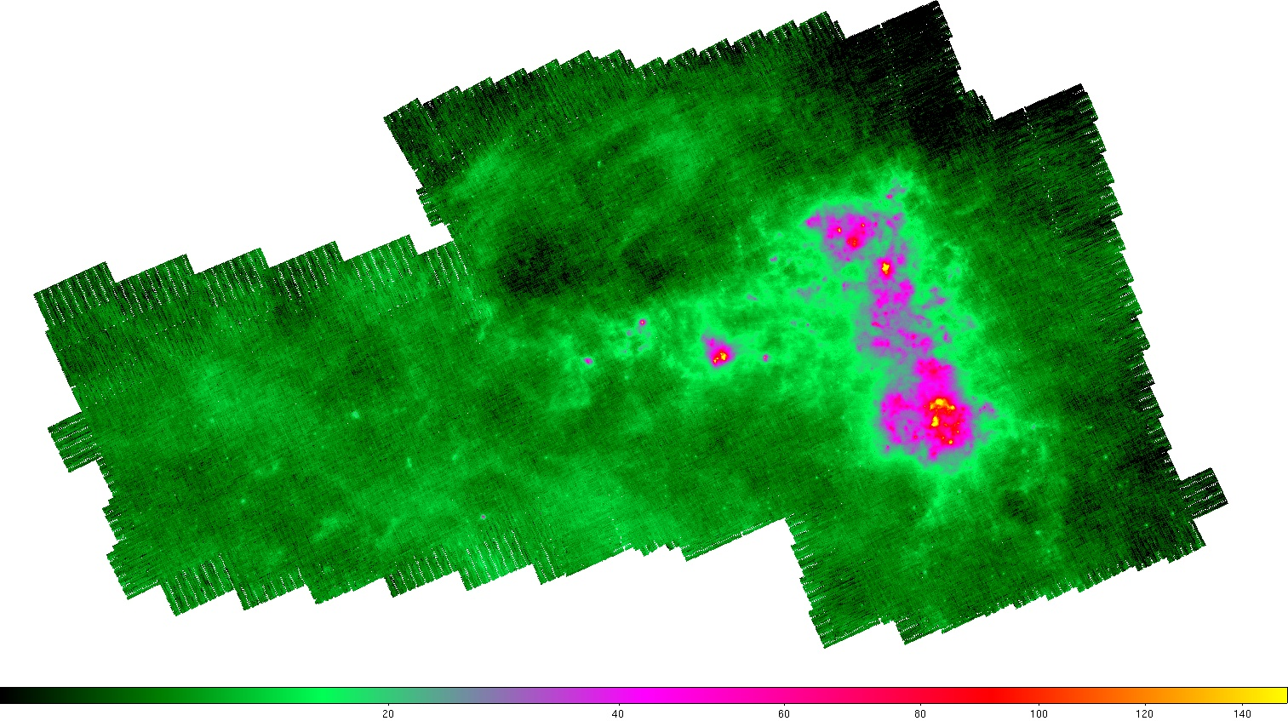
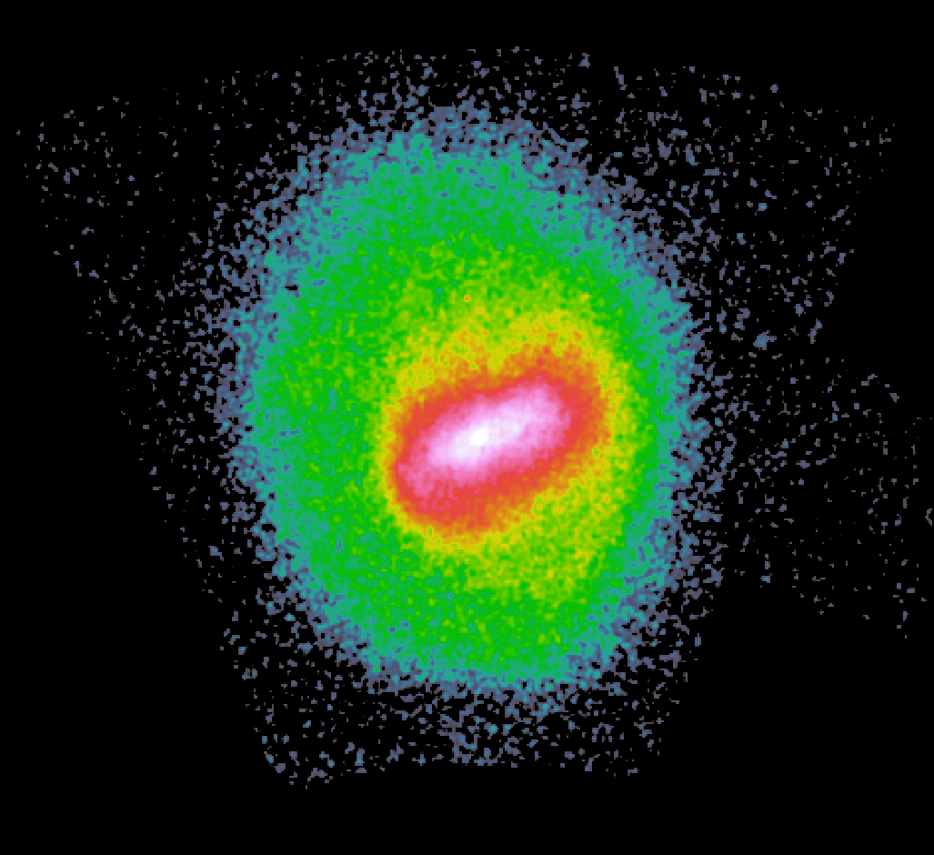
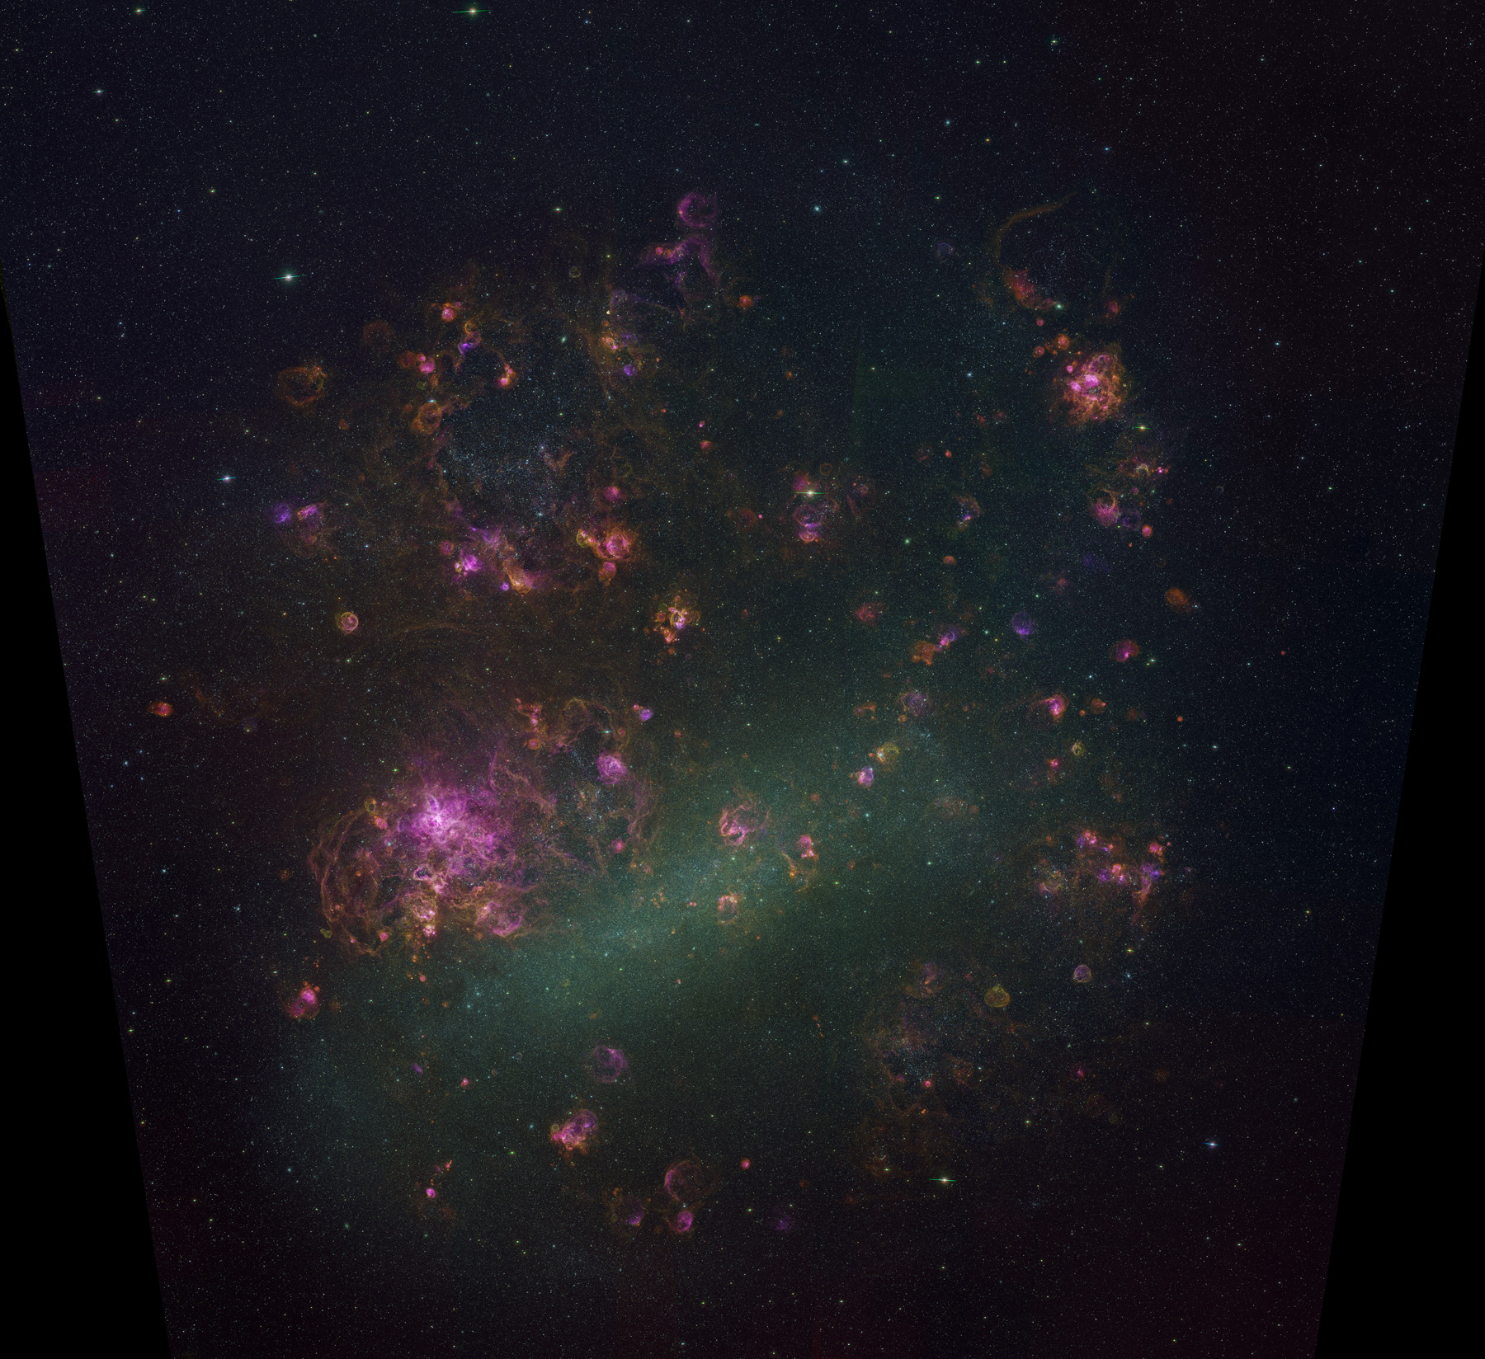
The Magellanic Clouds at Multiple Wavelengths
MCPS (UBVI)
DENIS (IJK)
2MASS (JHK_{s})
SAGE (IRAC+MIPS)
HI 21cm (ATCA, Parkes)
CO (NANTEN)
OGLE, OGLE-II, OGLE-III (BVI)
MACHO (BR)
SuperMACHO (V+R)
VMC (YJK_{s})
Various optical spectroscopic surveys
Spitzer SAGE
MCPS
Zaritsky et al. (2000)
3.6, 4.5, and 24 μm
Meixner et al. (2006); courtesy of K. Gordon
Spitzer 160 μm
ATCA+Parkes 21-cm map
2MASS+DENIS
photometry
MCELS
AGB and RGB stars
Gordon et al. (2011)
C. Smith and S. Points
van der Marel (2001)
Kim et al. (1998); Staveley-Smith et al. (2003)

Slide 5
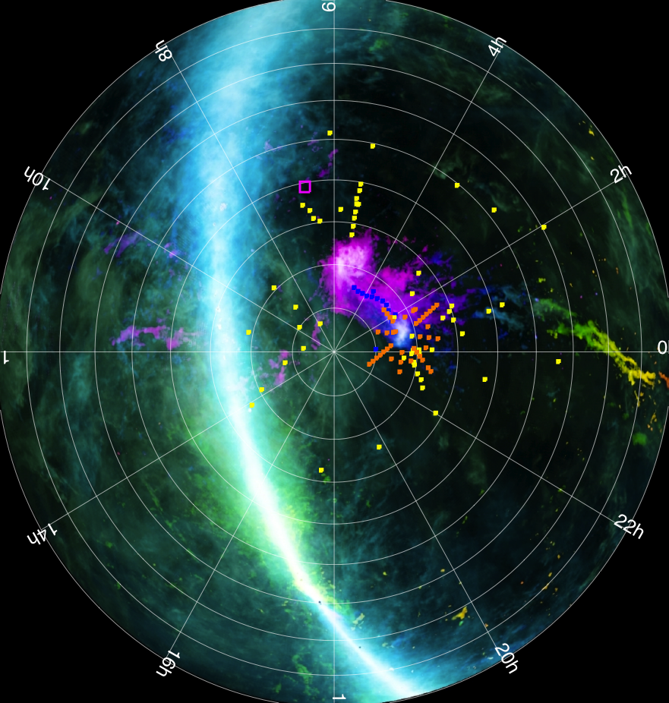
The Magellanic Clouds at Large Scales
The Magellanic Stream long viewed as evidence of tidal interaction between Magellanic Clouds and Milky Way (e.g. Gardiner & Noguchi 1996)
Image credit: S. Janowiecki and the Galactic All Sky Survey (McClure-Grifﬁths et al. 2009)

Slide 6
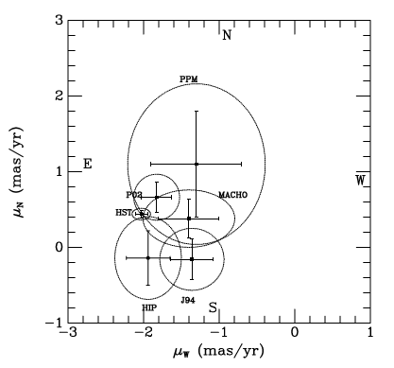
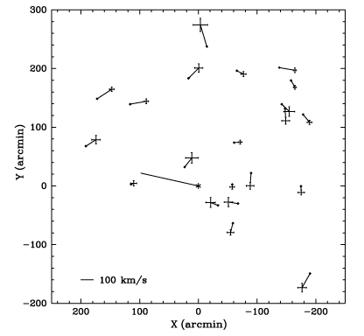
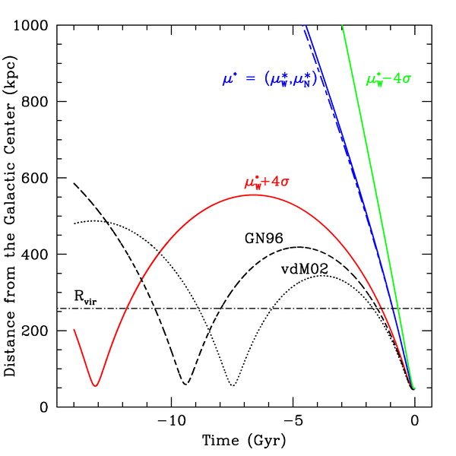
The Proper Motion of the LMC
Kallivayalil et al. (2006)
Piatek, Pryor, & Olszewski (2008)
Besla et al. (2007)
Kallivayalil et al. (2013)
The Magellanic Clouds likely on first infall
or highly elliptical orbit

Slide 7
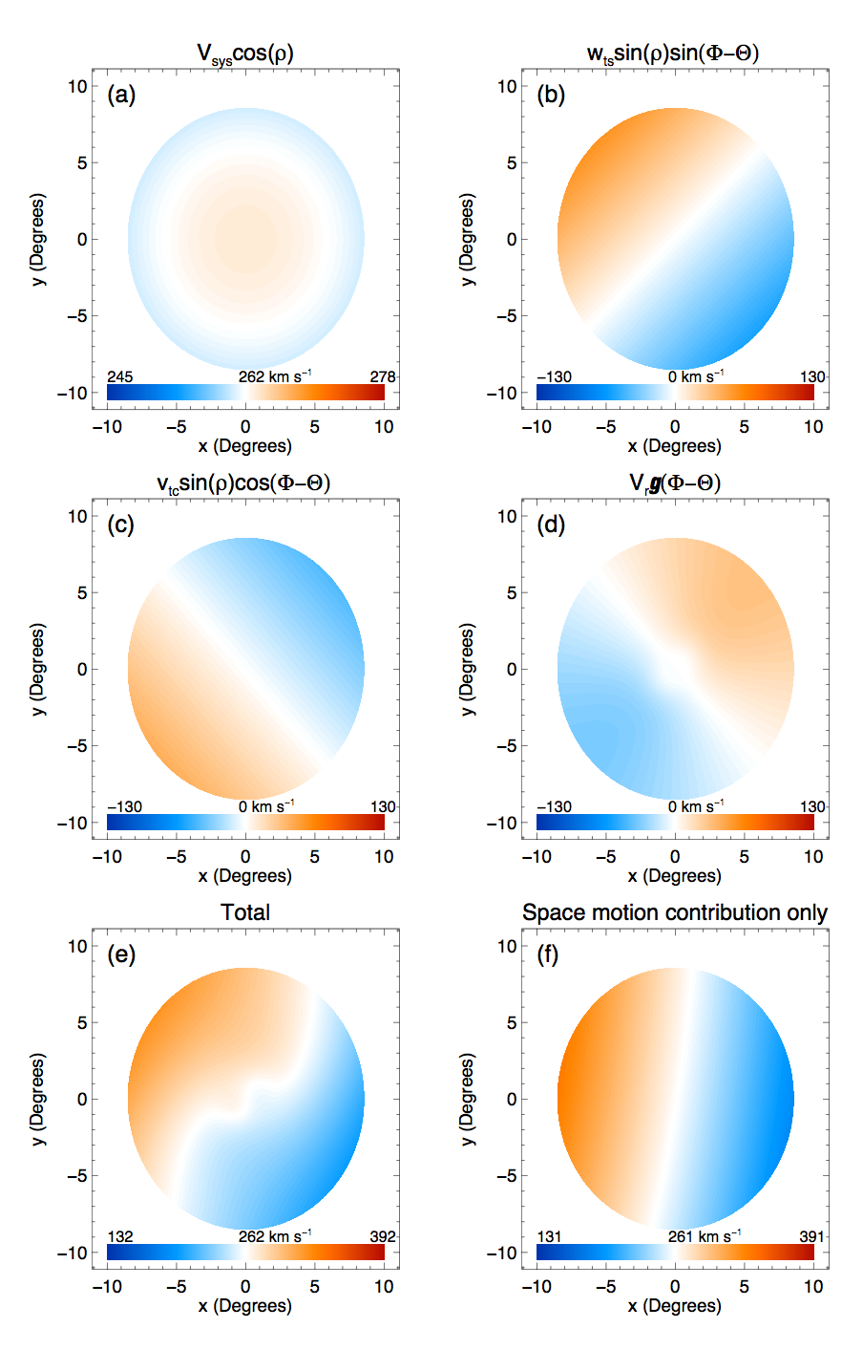
The Effect of the LMC’s large angular extent
v_{sys}
v_{t}
van der Marel et al. (2002)

Slide 8
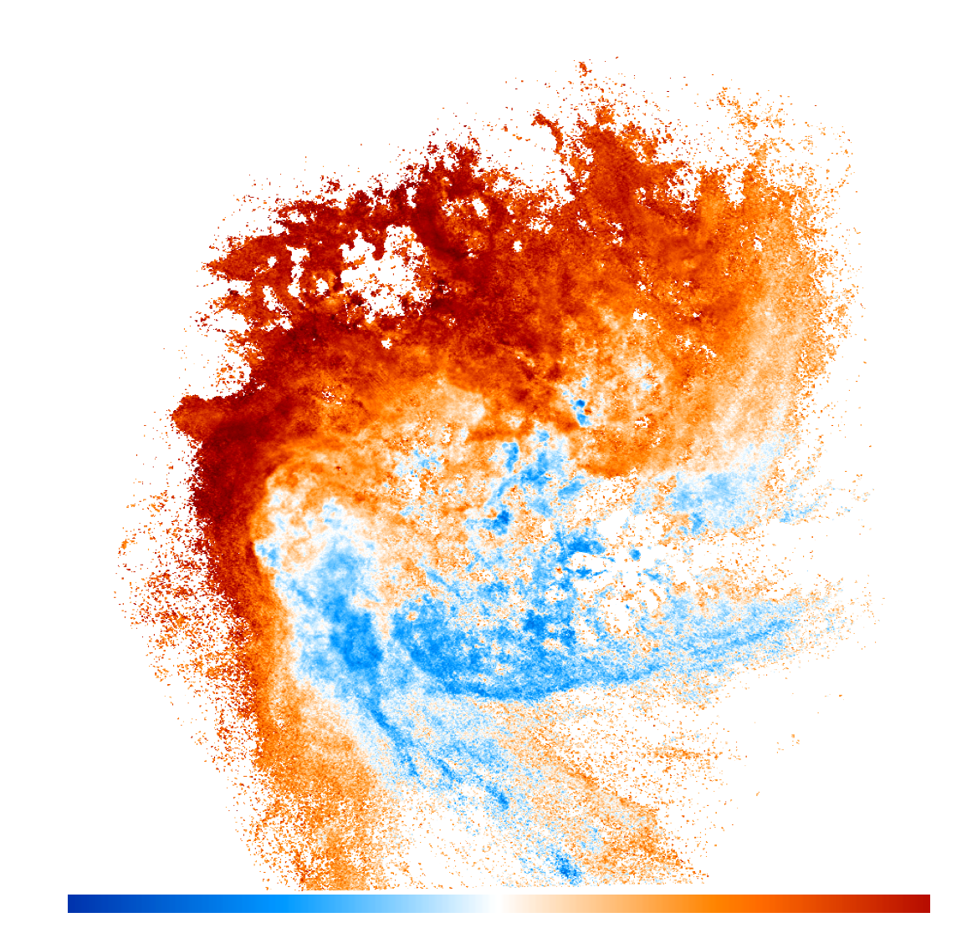
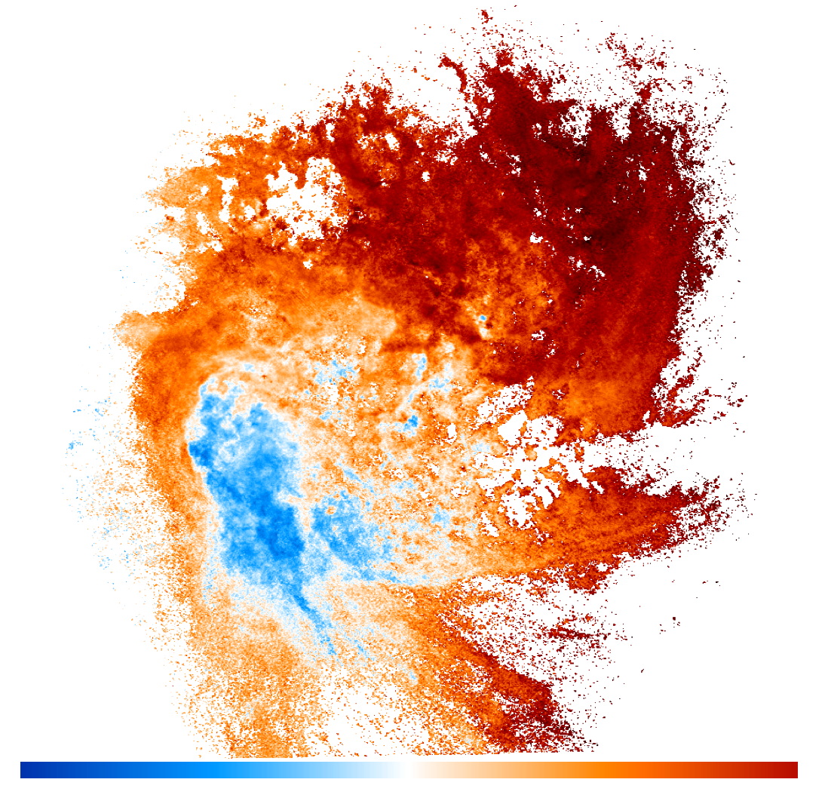
HI Kinematics
S
E
228 km s⁻¹
298 km s⁻¹
-35 km s⁻¹
B
35 km s⁻¹
Raw flux-weighted average velocities
Space motion contribution subtracted
Staveley-Smith et al. (2003)

Slide 9
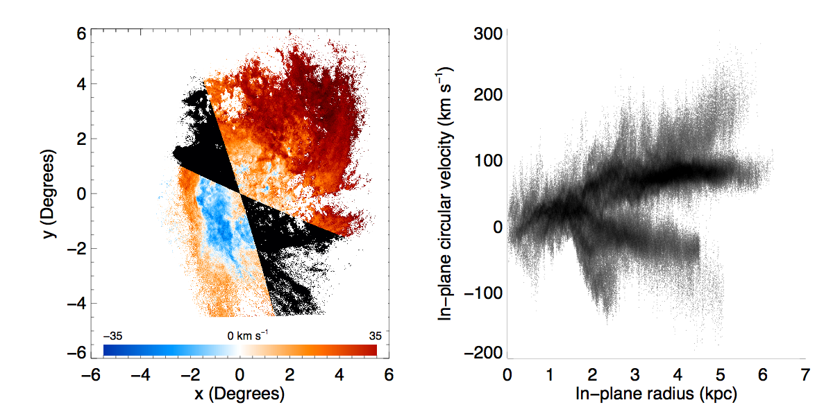
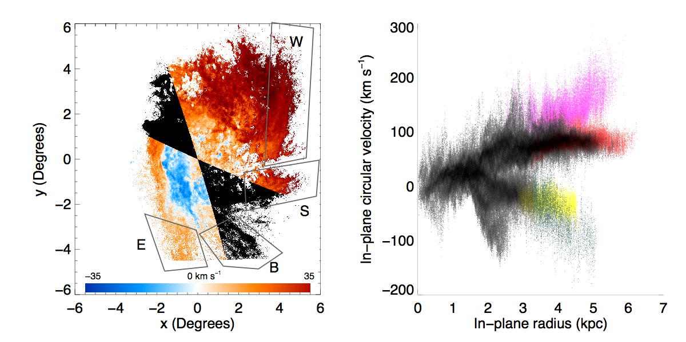
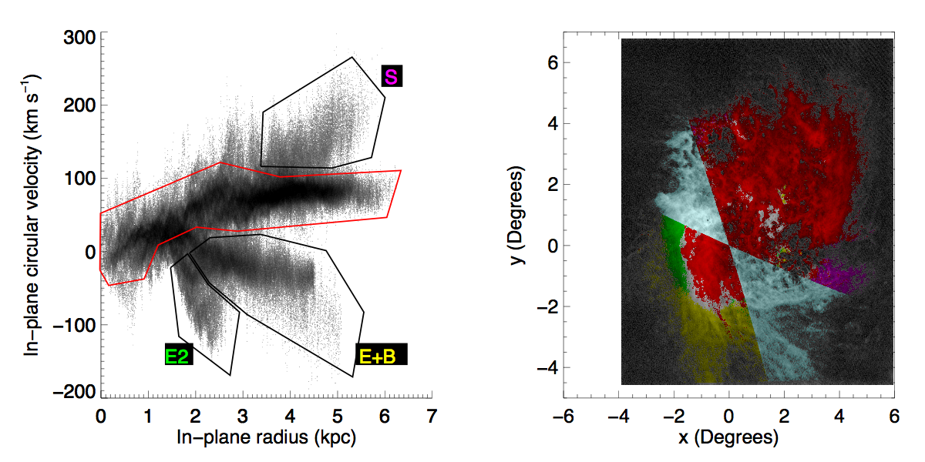
Deciphering the HI Kinematics
Olsen et al. (2007)
Assume residual velocity all due to circular motions in the plane of the LMC
Exclude regions where scale factor >5
V_{0,HI}~80 km s⁻¹

Slide 10
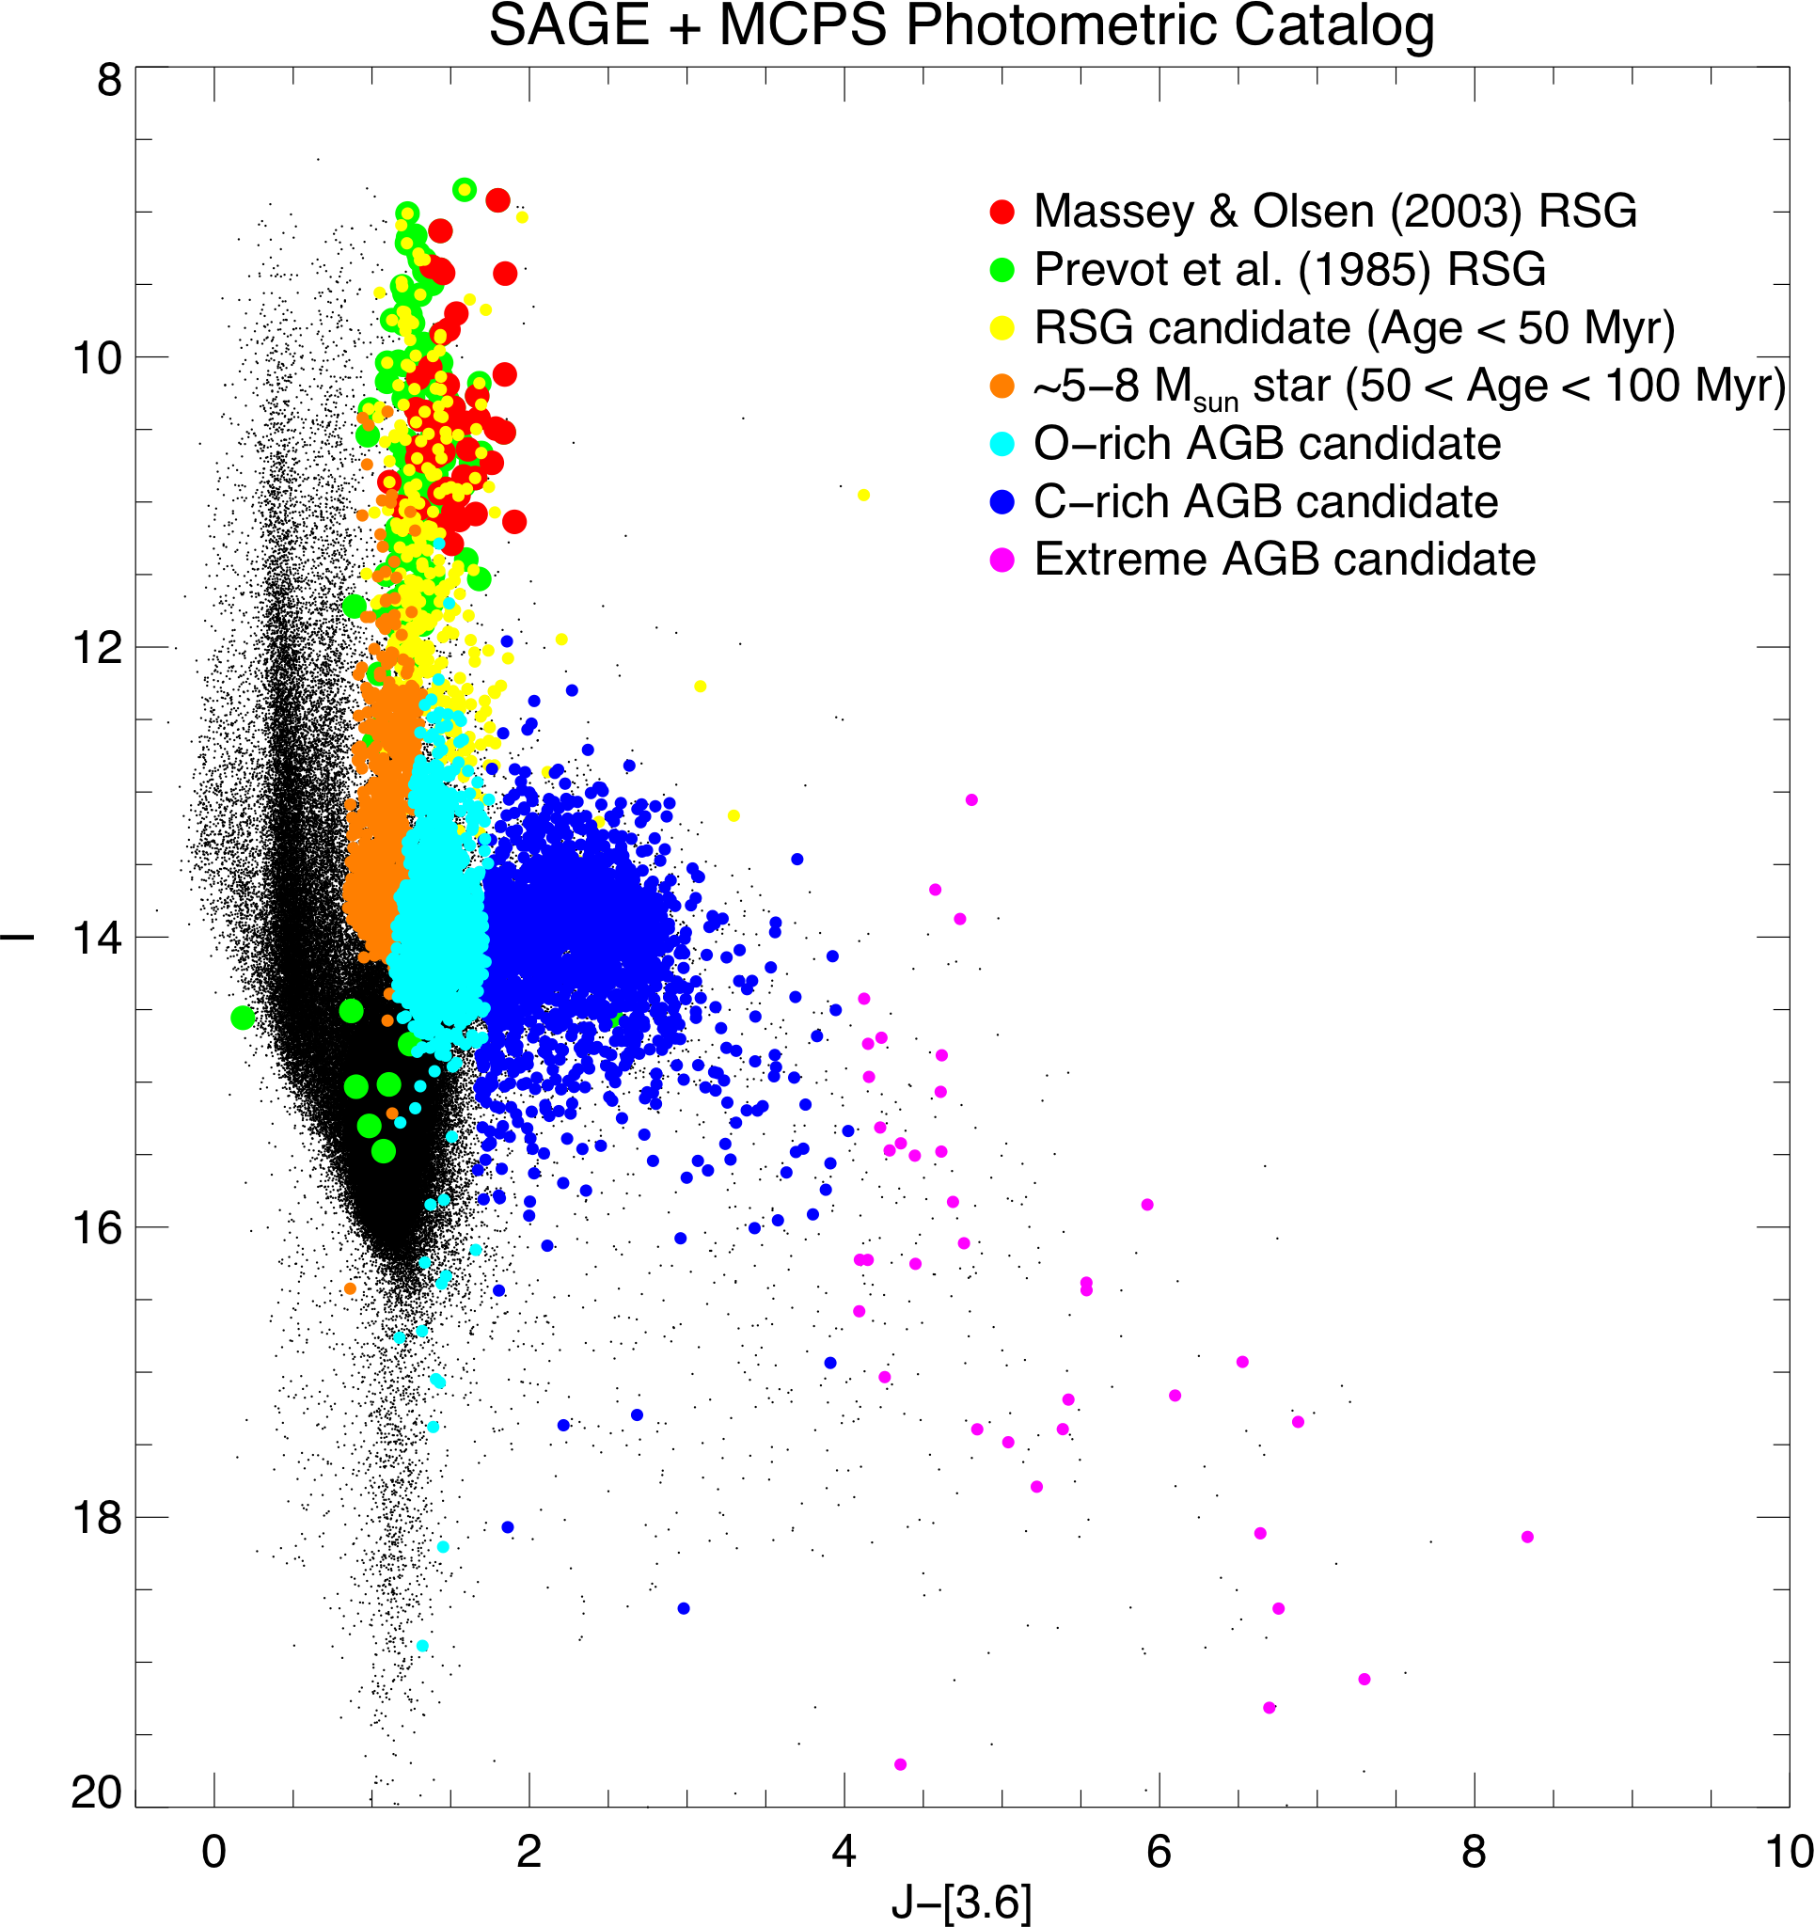
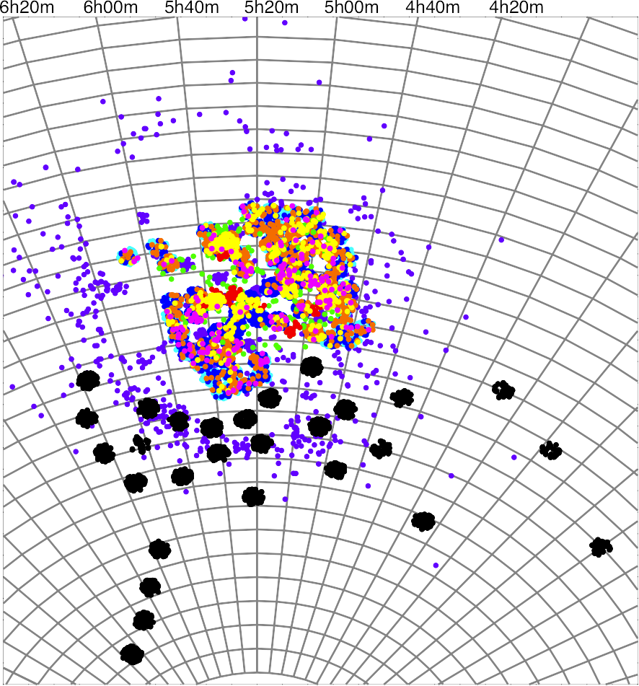
Observations
Selection of targets from Spitzer SAGE, MCPS, and 2MASS and DENIS surveys
Spectroscopy with CTIO 4-m + Hydra
Meixner et al. (2006)
~6500 spectra with CTIO 4-m + Hydra
Blum et al. (2006)
+Massey & Olsen (2003)
Zaritsky et al. (2004)
+Kunkel et al. (1997)
+Hardy et al. (in prep.)
Skrutskie et al. (2006)

Slide 11
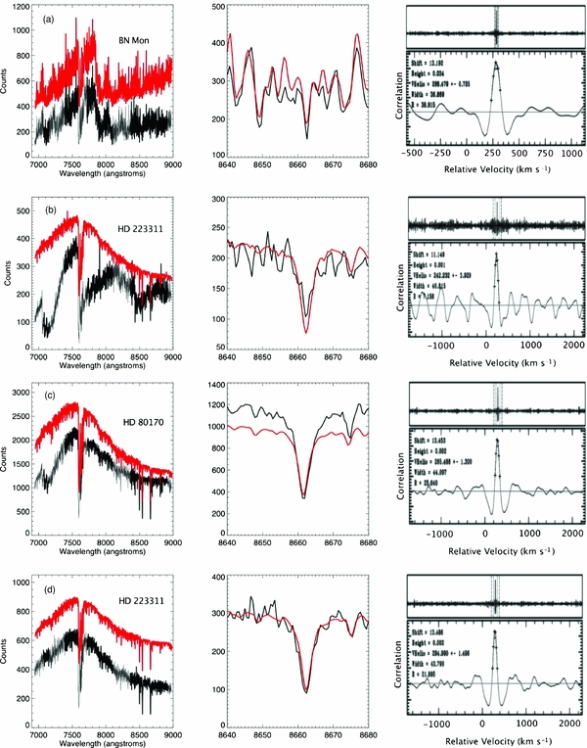
Measurements
Line-of-sight velocities from cross-correlation with observed templates (errors of 2-3 km s⁻¹)
Metallicities from Ca triplet equivalent widths for a subset of high S/N spectra

Slide 12
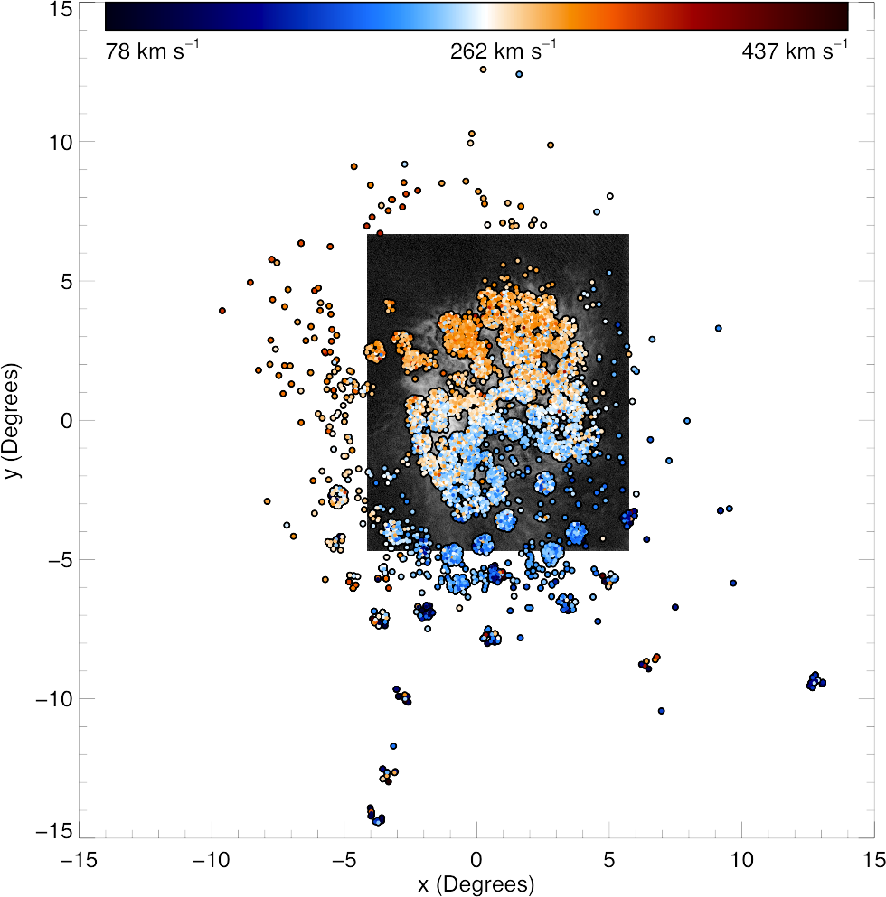
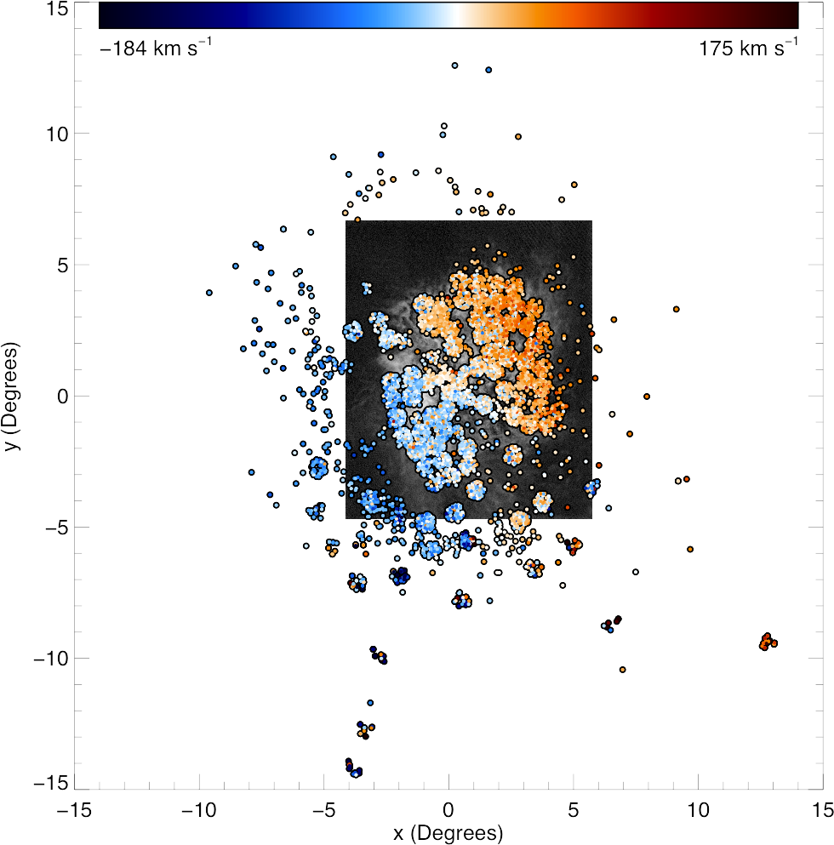
Results
Line of sight velocities after subtraction of space motion contribution

Slide 13
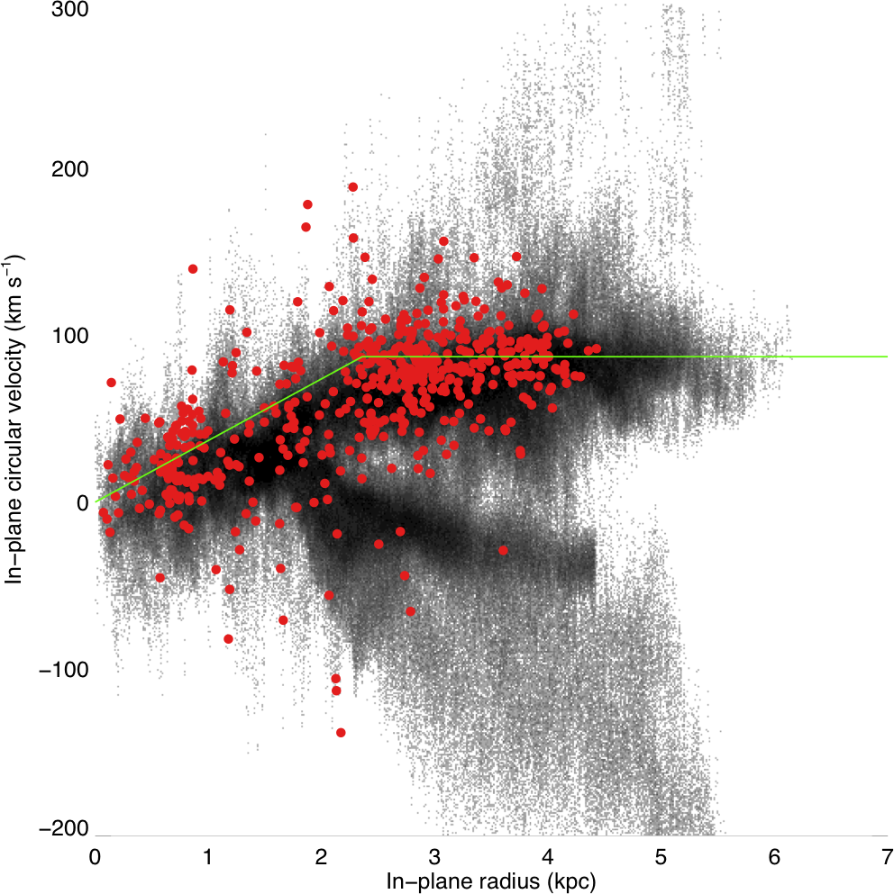
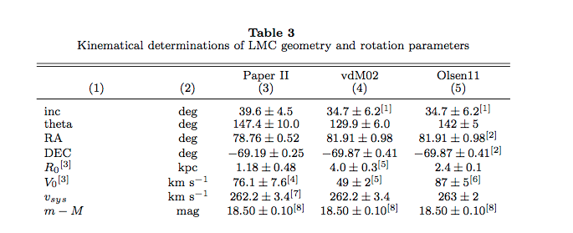
Results
Fitting to the young (RSG) population yields:
  v_{sys}=263 km s⁻¹ didt=-184 deg/Gyr
  θ=141˚.8 v₀=87 km s⁻¹
  r₀=2.35 kpc
The RSG fit agrees with the HI kinematics
Red supergiants only
Kallivayalil et al. (2013)

Slide 14
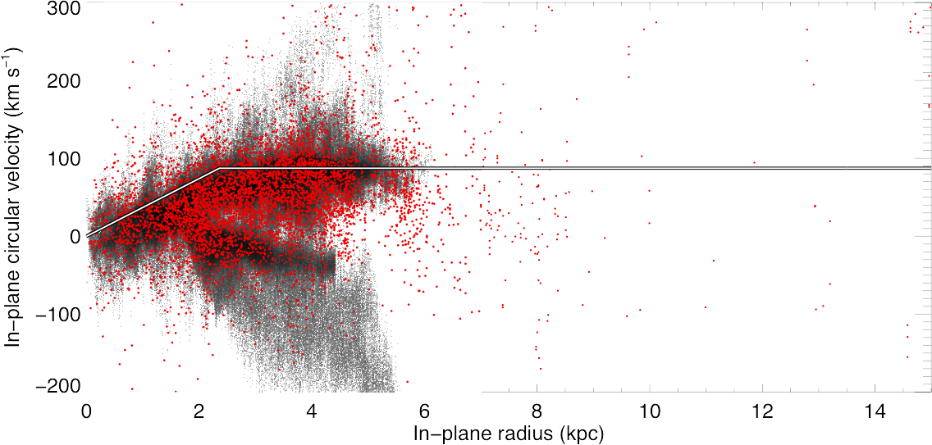
Results
All stars

Slide 15
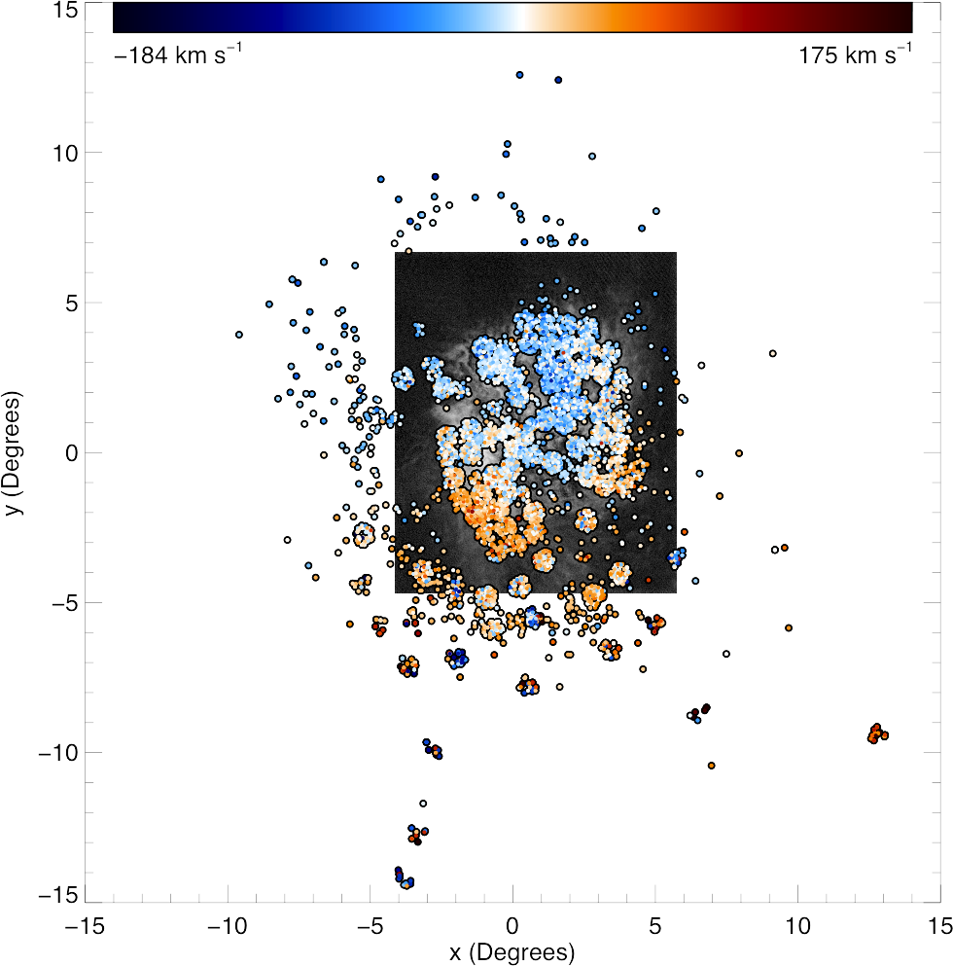
Results
Residuals from dynamical model

Slide 16
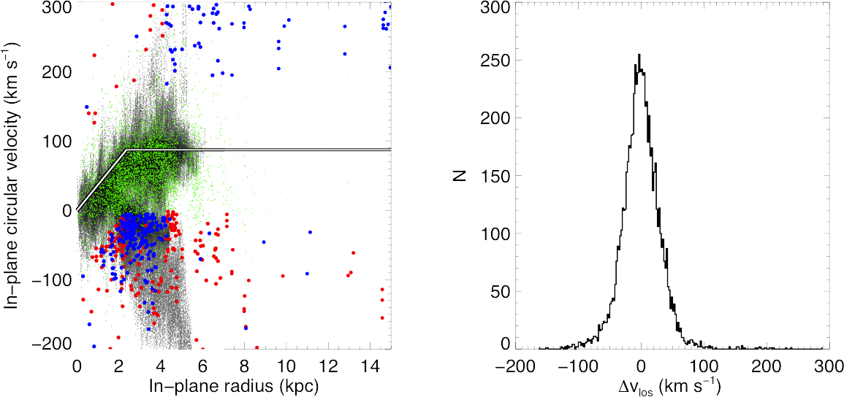
Results
The outliers are predominantly stars with kinematic signature of HI arms E and B

Slide 17
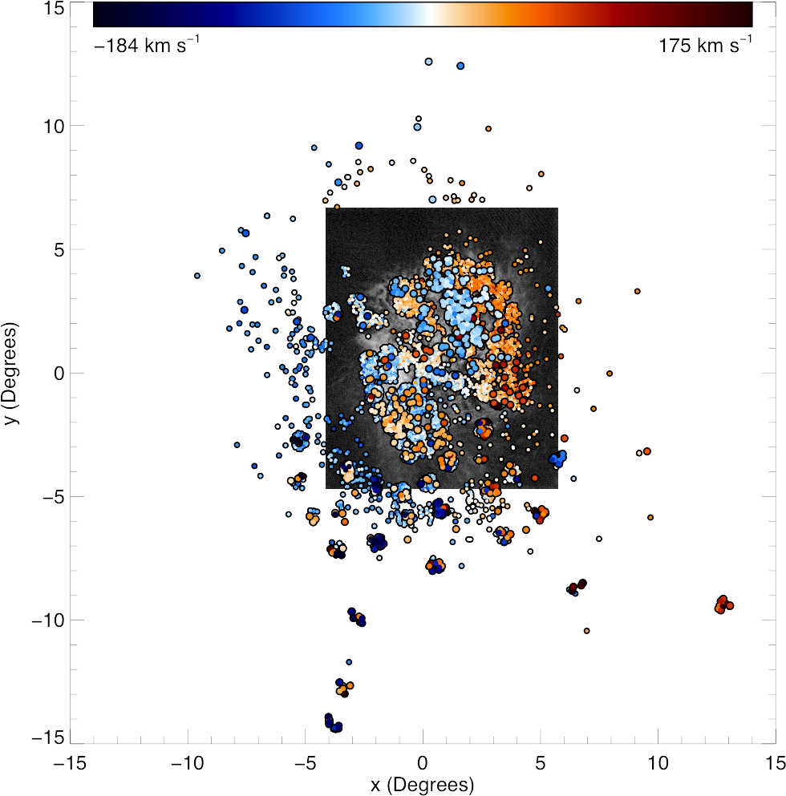
A closer look at the outliers
Space motion contribution subtracted

Slide 18
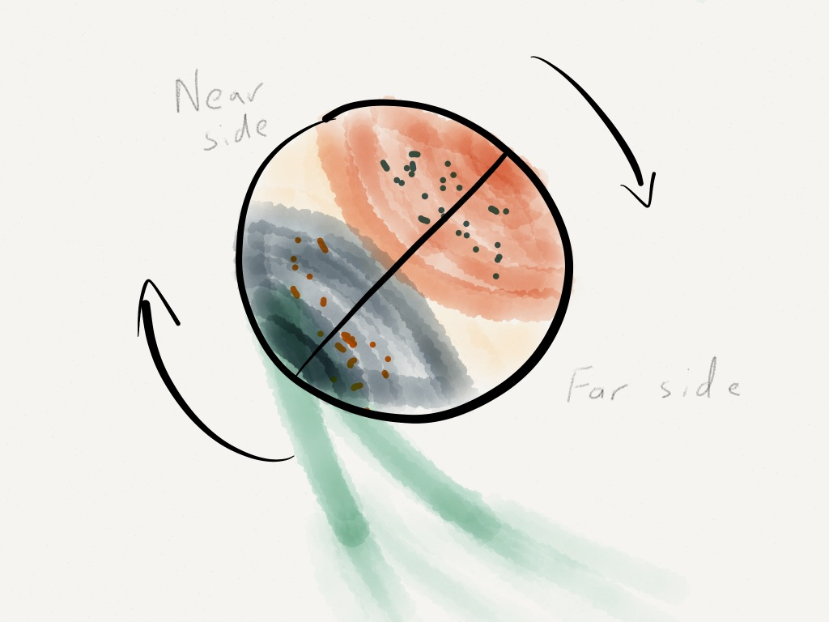
What Does It Mean?

Slide 19
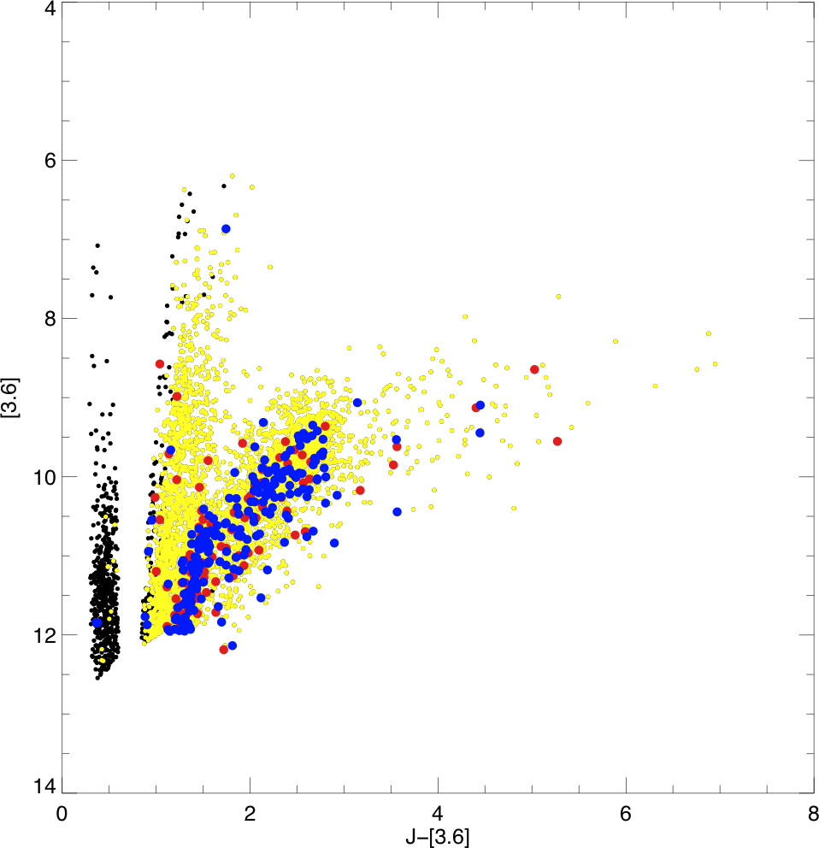
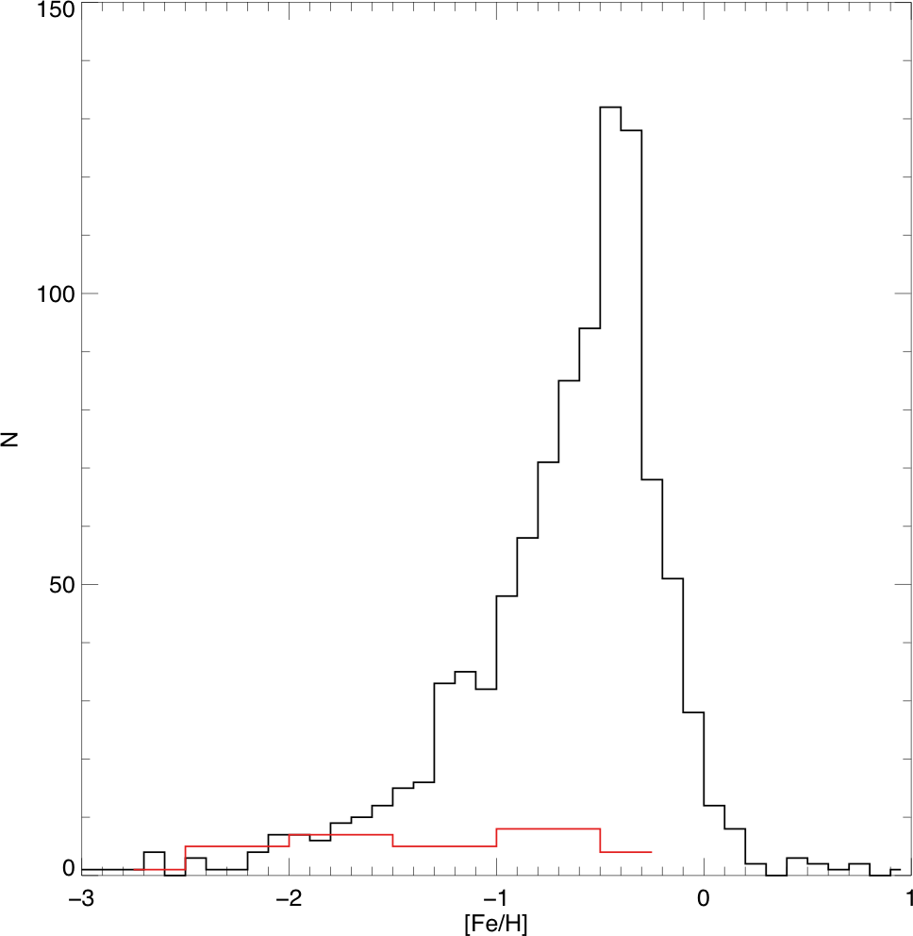
Metallicities of the outliers
LMC median: [Fe/H]=-0.56 +/- 0.5 (dispersion) Cole et al. (2005) LMC: -0.4 +/- 0.3
Outlier population median: -1.25 +/- 0.7 (dispersion) De Propris et al. (2010) SMC: -1.35 +/- 0.65

Slide 20
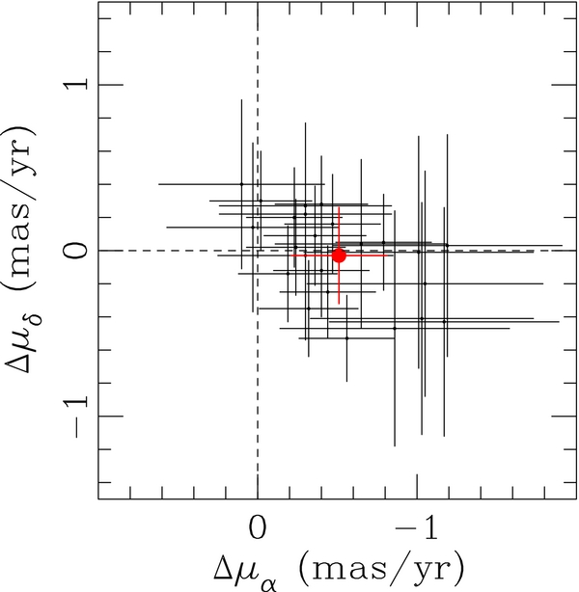
More dynamical evidence
Casetti-Dinescu et al. (2012) found proper motion signature in the outlier population
…but note contradictory conclusion by Radek (personal communication)

Slide 21
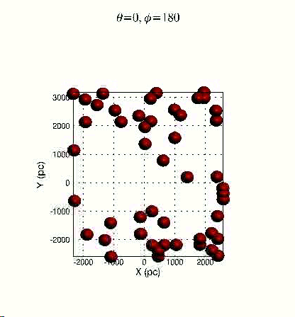
What Does It Mean?
Olsen & Salyk (2002)

Slide 22
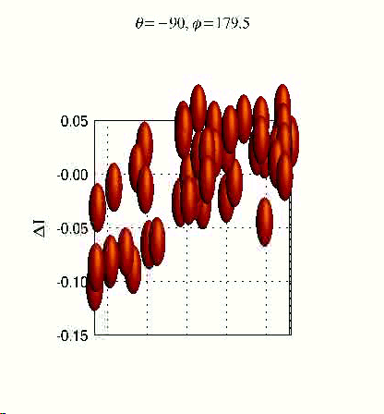
What Does It Mean?
Olsen & Salyk (2002)

Slide 23
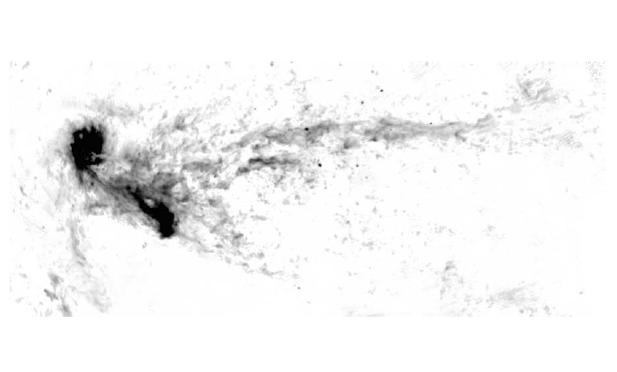
So what happened?
Magellanic Stream
LMC
SMC
Leading Arm
Where are the stars?
21-cm HI map from Putman et al. (2003)

Slide 24
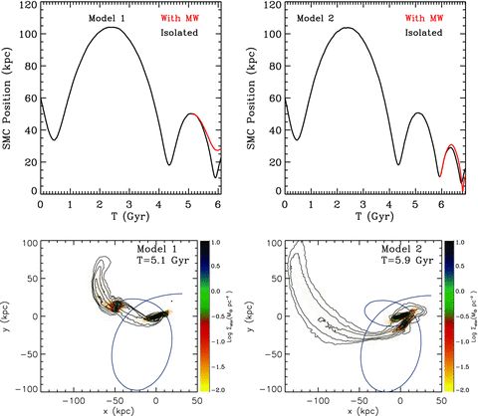
A model of the LMC-SMC interaction in a first infall scenario
Besla et al. (2012)
Notes:
Top panel: the separation of the SMC from the LMC is plotted as a function of time for Model 1 (left) and Model 2 (right). The black line denotes the orbital history when the LMC and SMC are modelled as an isolated binary pair: the MW’s potential is not included. The red line indicates how the separation between the MCs is modified after the pair first cross within R₂₀₀= 220 kpc of the MW. This occurs after 5.1 Gyr for Model 1 and after 5.9 Gyr for Model 2; these times are referred to as the stopping times for each model. Bottom panel: the gas column density of the isolated LMC–SMC system is projected in the binary orbital plane as contours over the stellar distribution at the stopping time for Model 1 (left) and Model 2 (right). Gas contours span a range of 10¹⁸–10²⁰ cm⁻², where each contour represents an increase in column density by a factor of 1.5. These images thus depict the gas distribution of the simulated system before it is influenced by the MW’s gravitational potential. An extended tail of gas is stripped from the SMC and a bridge of gas connects it to the LMC in both models (see also fig. 1 of B10).
© This slide is made available for non-commercial use only. Please note that permission may be required for re-use of images in which the copyright is owned by a third party.

Slide 25
A Direct collision?
Would explain stars as SMC tidal debris
SMC stars should be behind LMC, would then explain microlensing rate observed by MACHO (ongoing Axelrod program to test this)
Besla et al. (2012)
Notes:
The kinematics of SMC stars that are captured by the LMC in Model 1 (top panel) and Model 2 (bottom panel) are illustrated in the line‐of‐sight frame of the LMC’s disc. Only particles initially belonging to the SMC are plotted. The centre‐of‐mass velocity of the LMC’s stars has been subtracted from the velocity field of the transferred material. The left‐hand panels show the stellar density map with the highest density contours overplotted. The size of each box is 11 kpc per side, the same as that in Figs 14 and 15. The slits along the major and minor kinematic axes of the LMC are overplotted for reference. The colour gradient ranging from blue to red indicates material moving towards (blue) and away (red) from the observer.
© This slide is made available for non-commercial use only. Please note that permission may be required for re-use of images in which the copyright is owned by a third party.

Slide 26
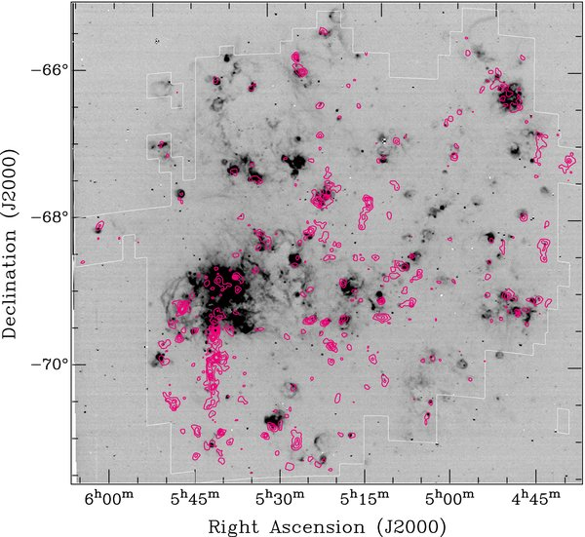
More consequences
Pileup of gas in LMC on eastern edge has always been a bit of a mystery
Gas collision would explain the pileup, and may have triggered star formation activity in 30 Doradus (Nathan Smith suggestion)
Kim et al. (1998); Staveley-Smith et al. (2003); Kawamura et al. (2009)

Slide 27
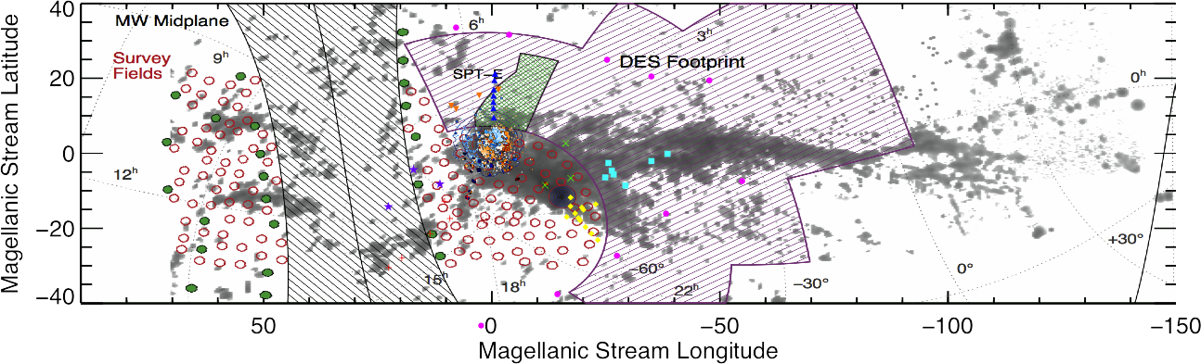
What next? SMASH!
Proposed SMASH DECam Survey: Nidever et al. See Blum poster!

Slide 28
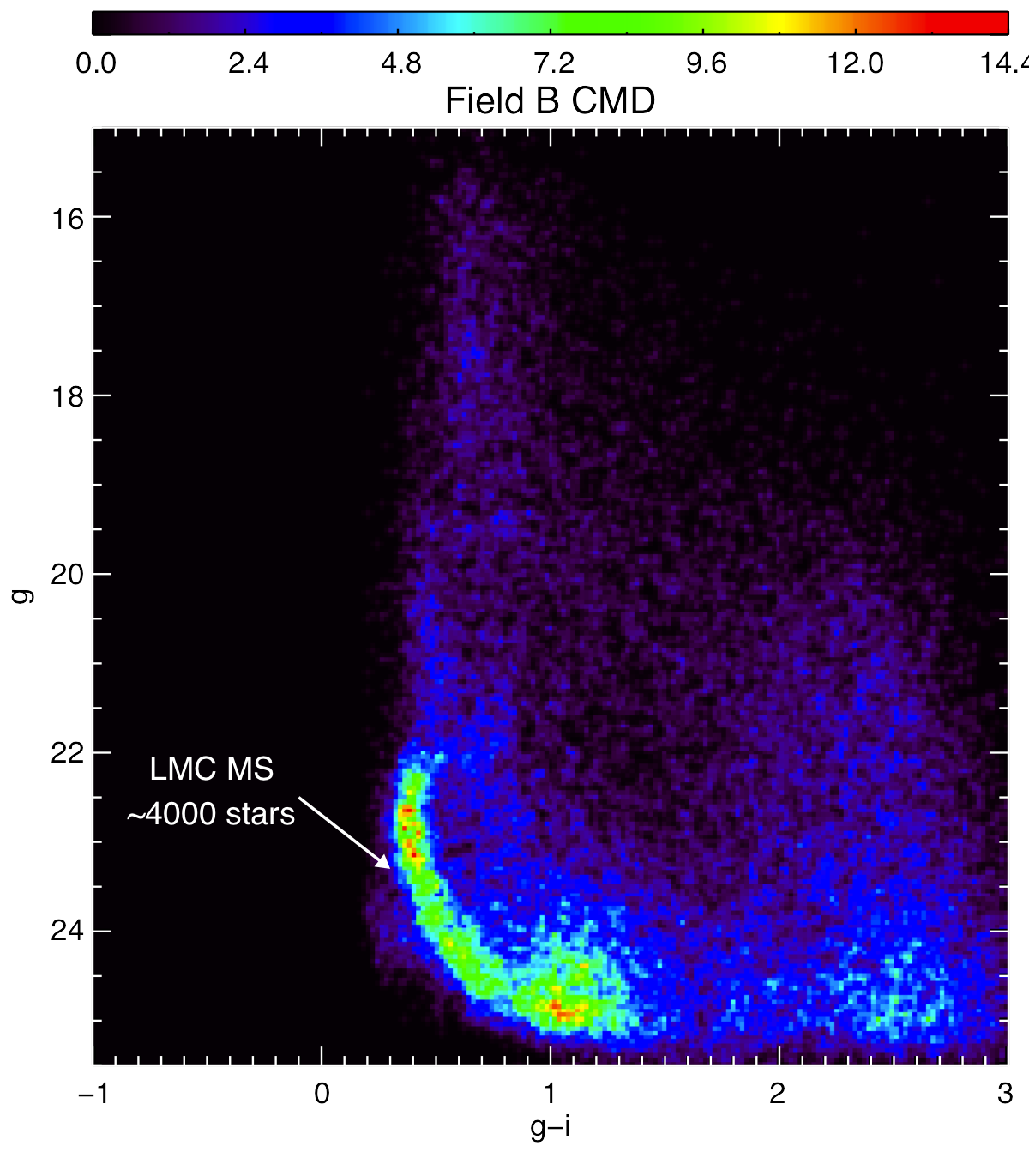
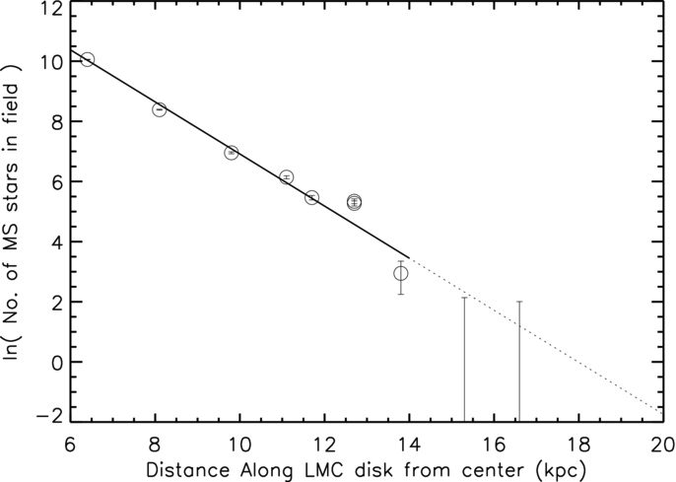
What next? SMASH!
Saha et al. (2010)
MSTO stars as tracers (Nidever et al.)

Slide 29
Conclusions
Have in hand ~7500 radial velocities of a range of LMC populations
Fitting to the young (RSG) population yields:
  v_{sys}=263 km s⁻¹ didt=-184 deg/Gyr
  θ=141˚.8 v₀=87 km s-1
  r₀=2.35 kpc
The RSG fit agrees with the HI kinematics
Examining the RSG fit against all stellar velocities, there is a dispersion of 26 km s⁻¹ and a significant number of outliers
Selecting the tails of the velocity residual distribution revealed a distinct population of stars, 5% of the full sample, with a kinematic signature similar to that of HI arms E and B, which connect to the SMC
Outliers have metallicities similar to SMC stars, and appear to have distinct proper motion
SMC stars may have been captured in a direct collision with LMC, could explain MACHO result, could have triggered 30 Doradus

Slide 30
Thank you CTIO!
For a great cultural experience (both Chile and observatory)
For great professional opportunities
For great friendships
For many important life events (such as the birth of my daughter!)
Many memories of those who have passed away: Bob Schommer, Hugo Schwarz, Manuel Hernandez, Mike Ledlow, Elizabeth Gregory, Laura Manquez, …

